Slide 1
Mid-Year Exam Review
Geometry 2014-2015

Slide 2
Quadrilateral Family

Slide 3
Parallelogram family
Ordinary Parallelograms
Rhombuses
Squares
Rectangles

Slide 4
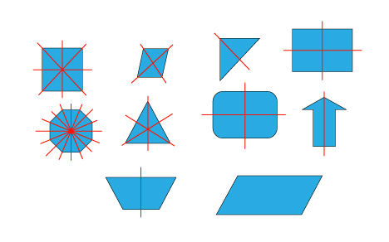
Line of Symmetry
The folding line is called line of symmetry.

Slide 5
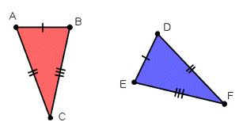
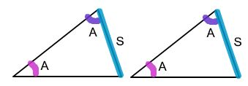
The Triangle Congruence Postulates

Slide 6
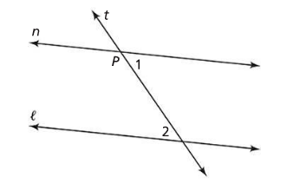
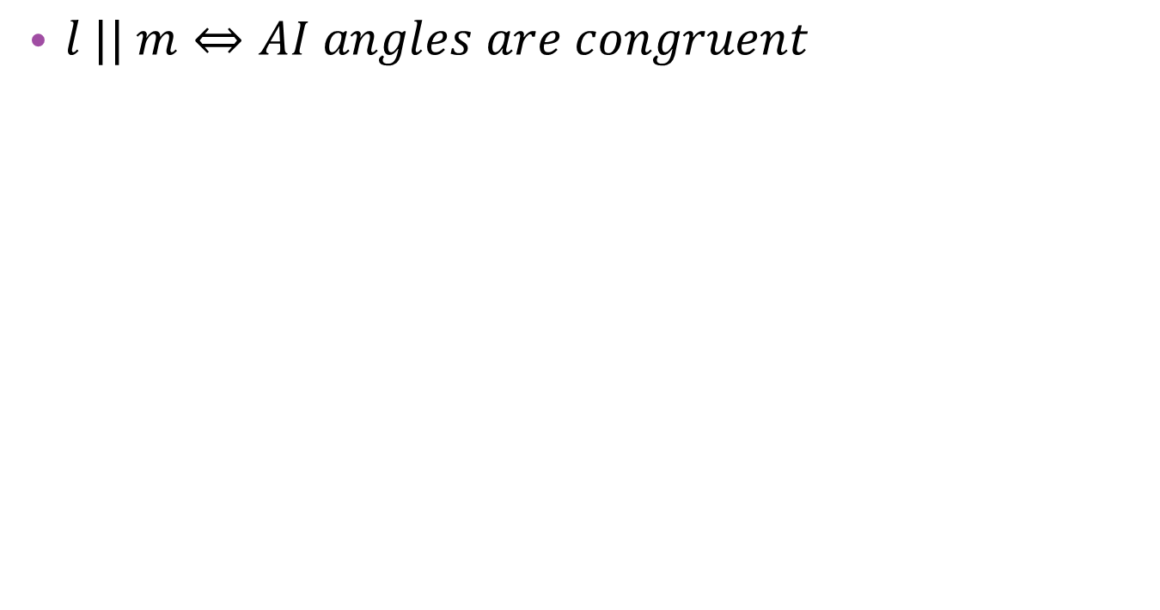
The AIP/PAI Theorem
$l || m⇔AI angles are congruent$

Slide 7
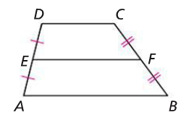
Theorem 3.1
$\overline{DC}, \overline{EF}, and \overline{AB} are parallel$.
$AB+DC is half of EF$

Slide 8
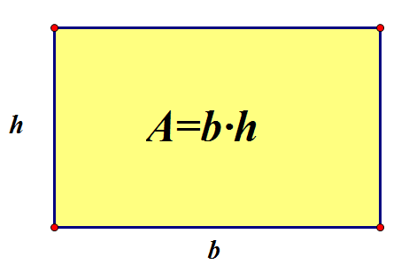
The Rectangle Postulate

Slide 9
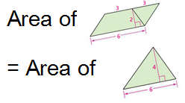
The Scissors-Congruence Postulate

Slide 10
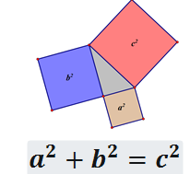
The Pythagorean Theorem

Slide 11
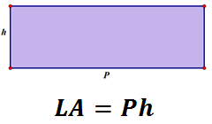
LSA of prism and cylinder

Slide 12
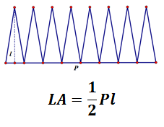
LSA of Pyramid and cone

Slide 13
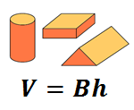
Volume of prism or cylinder

Slide 14
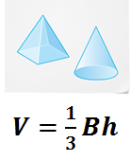
Volume of pyramid and cone

Slide 15
Cumulative Review page 350 and 351
Solve
Problem 3, 5-8, 12, 14

