Slide 1
Quarterly Test 2 Prep
CME Geometry
Mr. Tanaka

Slide 2
In 2D, you learned how to
Classify Quadrilaterals
Understand the meaning of converse
Understand the meaning of always, never, and sometimes in mathematics

Slide 3
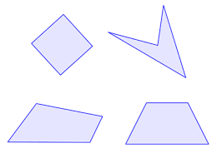
Definition of Quadrilateral
Four segments
The sides intersect at their endpoints.
Each vertex is the endpoint of exactly two sides.

Slide 4
Quadrilateral Family

Slide 5
Parallelogram family
Ordinary Parallelograms
Rhombuses
Squares
Rectangles

Slide 6
Theorem 2.7
$ABCD is a parallelogram$
$$⇒ABC≅CDA$$

Slide 7
Theorem 2.8
$ABCD is a parallelogram$
$⇒\overline{BE}≅\overline{ED} and \overline{AE}≅\overline{EC}$

Slide 8
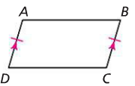
Theorem 2.9
$\overline{AB}∥\overline{CD} and \overline{AB}≅\overline{CD}⇒ABCD is a parallelogram.$

Slide 9
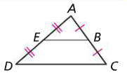

The MidLine Theorem
$\overline{EB} is a midline of ΔACD$
$$⇒\overline{EB}∥\overline{DC} and EB=\frac{1}{2}DC$$

Slide 10
In 3A, you learned how to
Change one shape into another by making cuts and rearranging the parts
Tell when two shapes are scissors-congruent
Prove the Midline Theorem using cuts and rearrangement

Slide 11
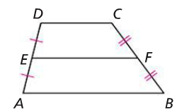
Theorem 3.1
$\overline{DC}, \overline{EF}, and \overline{AB} are parallel$.
$AB+DC is half of EF$

Slide 12
In 3B, you learned how to
Calculate the area of a parallelogram, of a triangle, and of a trapezoid
Prove the formulas for calculating the areas above
Tell the difference between two figures being scissors-congruent and having the same area

Slide 13
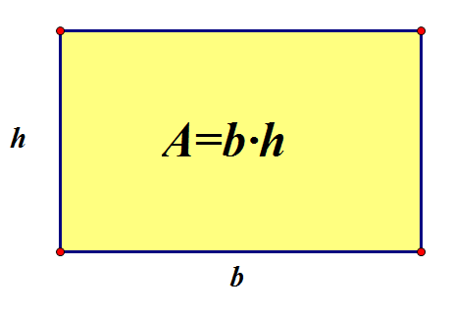
The Rectangle Postulate

Slide 14
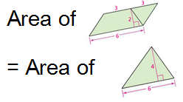
The Scissors-Congruence Postulate

Slide 15
In 3C, you learned how to
Follow the logical reasoning and fill in missing steps in proofs of the Pythagorean Theorem
Identify the critical features in a proof without words
See where and how to use the Pythagorean Theorem to find missing lengths in figures

Slide 16
In 3D, you learned how to
Find the surface area of solids by visualizing their nets
Estimate the volumes of solids
Use Formulas for the volumes of certain solids

Slide 17
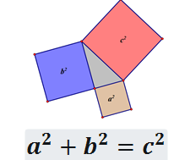
The Pythagorean Theorem

Slide 18
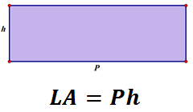
LSA of prism and cylinder

Slide 19
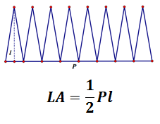
LSA of Pyramid and cone

Slide 20
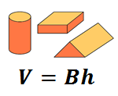
Volume of prism or cylinder

Slide 21
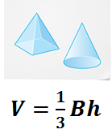
Volume of pyramid and cone

Slide 22
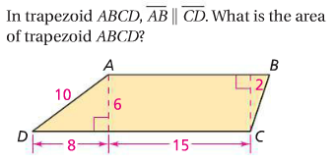
Some problem

Slide 23
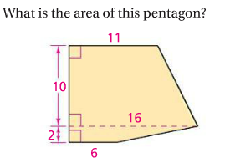
Some problem

Slide 24
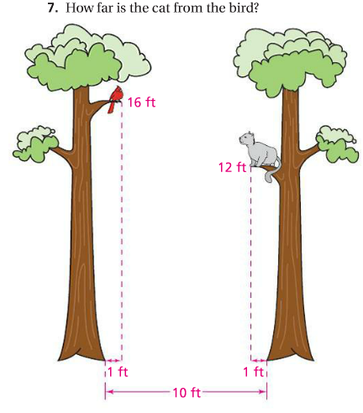
Some problem

Slide 25
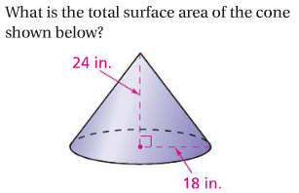
Some problems

Slide 26
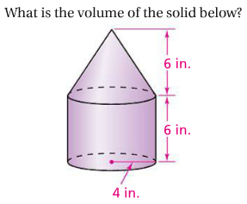
Some problems

