Slide 1
Quarterly Review
CME Geometry Chapter 1 and 2

Slide 2
Vocabulary
Line of symmetry
Line segment
Parallel lines/ planes
Prism
Altitude
Angle bisector
Perpendicular bisector
Equilateral/ Equidistant
Median
Midline
Midpoint
Congruent
Alternate interior angles
Consecutive angles
Corresponding angles
Supplementary angles
Transversal
Vertical angles

Slide 3

Notations
$\overset{⃡}{CD}$ (line CD)
$\overline{AB}$ (segment AB)
$∠ACB$
≅ (is congruent to)
$JK$ (length of $\overline{JK}$)
⊥ (Is perpendicular to)
≇ (is not congruent to)
∥ (is parallel to)

Slide 4
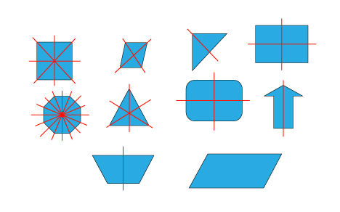
Line of Symmetry
The folding line is called line of symmetry.

Slide 5
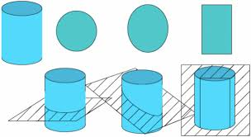
Cross Section
Is the face you get when you slice an 3-D object.

Slide 6
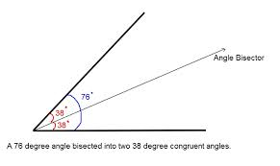
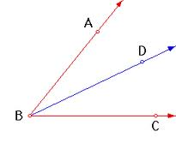
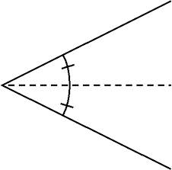
Angle Bisector
A segment that split an angle in half.

Slide 7
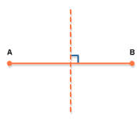
Perpendicular Bisector
Is a line that:
Cross perpendicularly to a segment; and
Splits the segment in half.

Slide 8
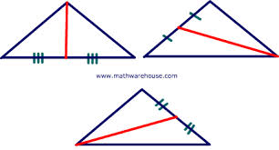
Median
A triangle has three medians.
Is a segment that connects a vertex of a triangle to the midpoint of the opposite side.

Slide 9
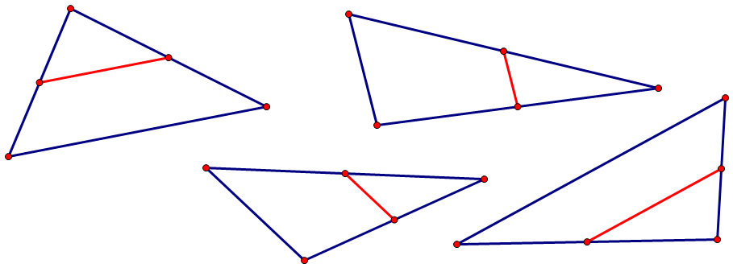
Midline
A triangle has three midlines.
Is a segment that connects the mid points of two sides of a triangle.

Slide 10
$180(n−2)$°
The sum of interior angles of a polygon is $180(n−2)$ degrees.

Slide 11
Geometric figures are CONGRUENT
A geometric figure means points, segments, angles, triangles, quadrilaterals, pentagons, etc.
$\overline{JK} ≅ \overline{LM}$
$∠NPQ∠RST$
$∠P  ∠S$
$∆ABC∆DEF$
$□ABCD  □EFGH$

Slide 12
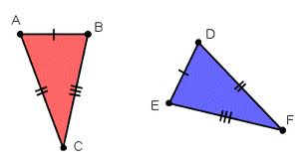
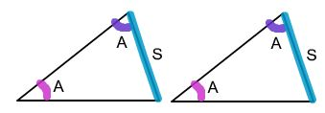
The Triangle Congruence Postulates

Slide 13

Exterior Angle Theorem
$m∠4=m∠1+m∠$2

Slide 14
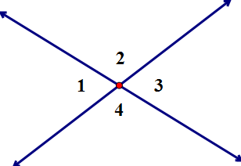
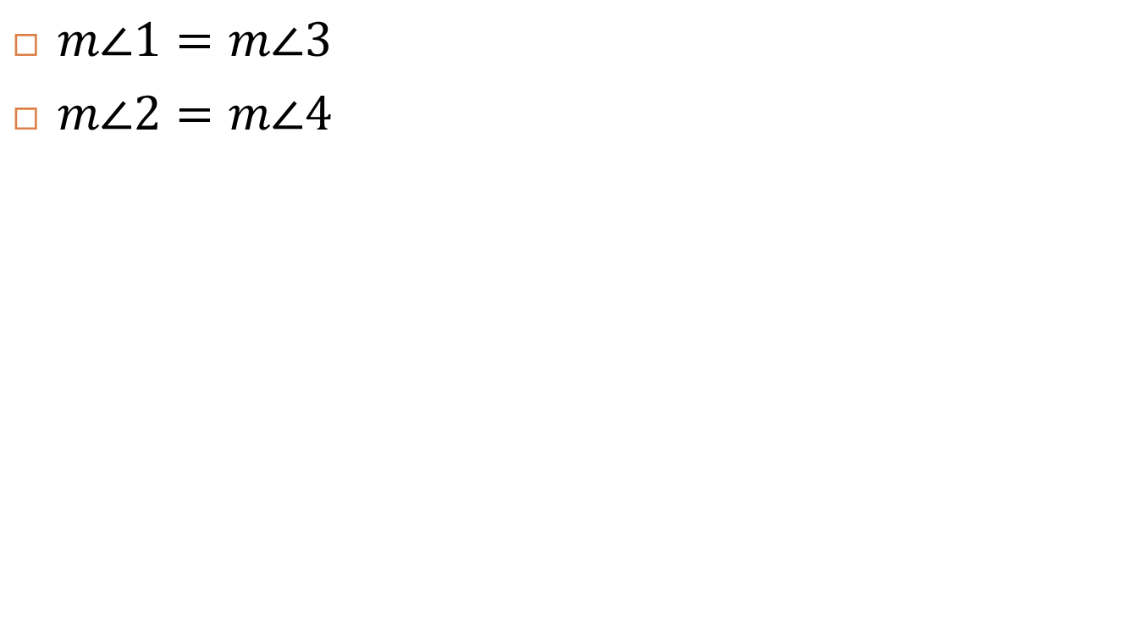
Vertical Angles Theorem
$m∠1=m∠3$
$m∠2=m∠4$

Slide 15
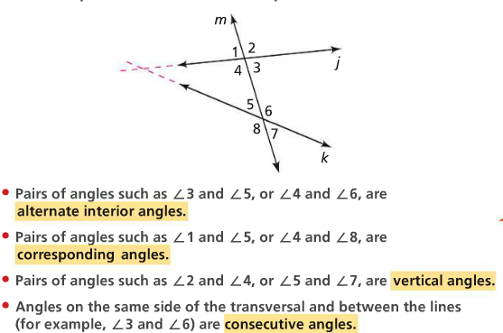
Facts and Notation

Slide 16
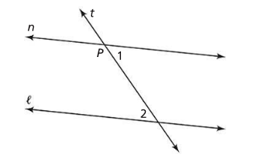

The AIP/PAI Theorem
$l || m⇔AI angles are congruent$

Slide 17
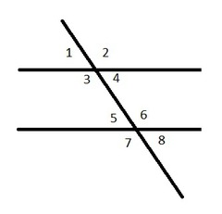
IF $l ǁ m$,
Alternate interior angles are congruent.
Corresponding angles are congruent.
Consecutive angles are supplementary.
$m∠3+m∠5=180$
$m∠4+m∠6=180$

Slide 18
Problem
Draw the letters M, A, T, and H as block letters. Then describe the planes of symmetry of each letter.

Slide 19
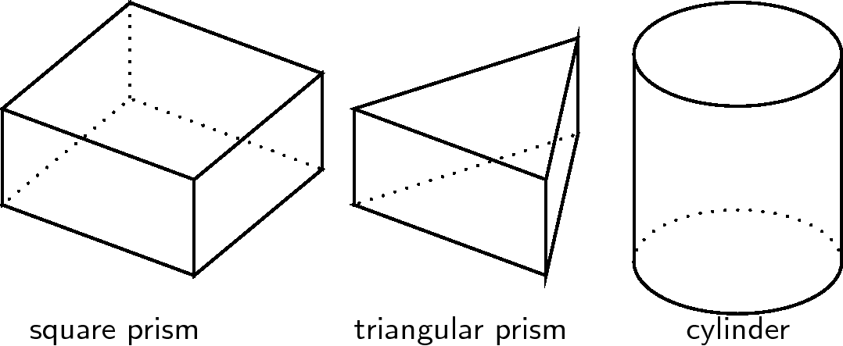
Problem
What shadows can each shapes cast?
What shapes of cross section can you form with the figures below?

Slide 20
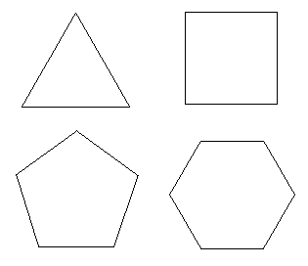
Problem
How many lines of symmetry can you draw with the figures below?

Slide 21
Problem
What solids can you make with each net below?

Slide 22
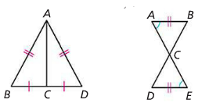
Problem
For each figure, write a congruence statement and prove the statement.

Slide 23
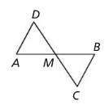
Problem
In the figure below, $M$ is the midpoint of $\overline{AB}$ and $\overline{CD}$. Prove that $ADM≅BCM$.

Slide 24
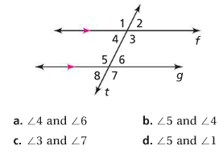

Problem
In the figure below, $f ǁ g$. Classify each pair of angles as alternate interior angles, consecutive angles, or corresponding angles.

Slide 25
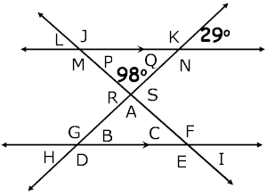
Problem
Find the measurement angles A – S

