Slide 1
What were we doing in 7B?
Geometry Mathematical Reflection 7B

Slide 2
In this investigation,
You learned how to
Calculate the distance between two points with given coordinates
Calculate the coordinates of the midpoint of a segment
Prove algebraically that three points are or are not collinear
Recognize when two lines are parallel or perpendicular
Plot points in three dimensions and find the distance between them

Slide 3

Vocabulary and Notation
Ordered triple
$z$-axis
$V_{1}$ (“V sub 1”)

Slide 4
Big Idea
The coordinate plane in two and three dimensions
The midpoint and distance formulas
Prove three points are collinear
Identify parallel and perpendicular lines

Slide 5
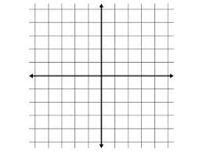
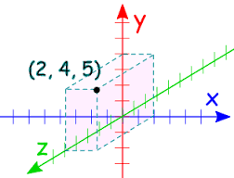
Coordinate planes in 2D and 3D

Slide 6
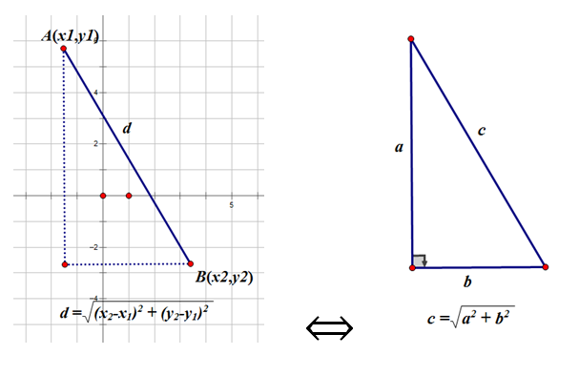

Distance Formula
$d=\sqrt{{\left(x_{2}{−x}_{1}\right)}^{2}{+\left(y_{2}−y_{1}\right)}^{2}}$

Slide 7
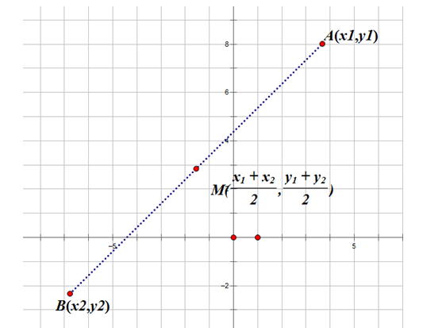
Midpoint Formula
$M\left(\frac{x_{1}+x_{2}}{2},\frac{y_{1}+y_{2}}{2}\right)$ for $A\left(x_{1}, y_{1}\right), B(x_{2},y_{2})$

Slide 8
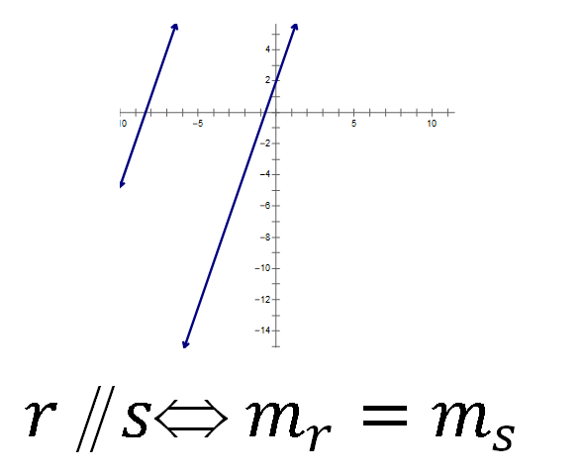
Theorem 7.4
Two lines are parallel if and only is the slopes are equal.

Slide 9
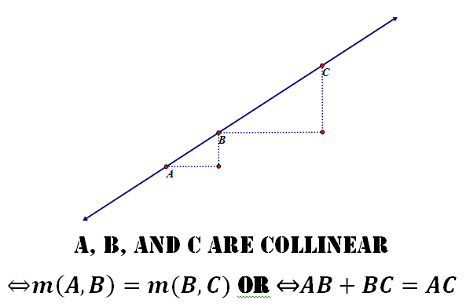
Theorem 7.5
Three points are collinear if and only is the slopes of each pairs are equal.
Three points are collinear if and only the sum of lengths AB and BC is equal to the length of the AC

Slide 10
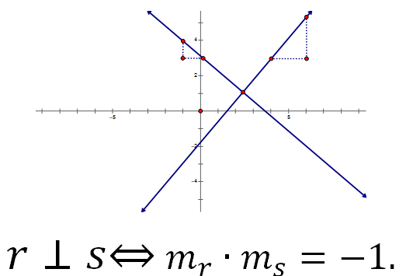
Theorem 7.6
Two lines are perpendicular if and only if the product of slopes are -1.

Slide 11
Discussion Question
Q. How can you tell y examining the coordinates of two points whether thy lie on a horizontal line? On a vertical line?
A.
Two points lie on the same horizontal line if and only if their $y$-coordinates are equal.
Two points lie on the same vertical line if and only if their $x$-coordinates are equal.

Slide 12

Discussion Question
Q. How do you calculate the distance between two points?
A.
Distance formula $d=\sqrt{{\left(x_{2}−x_{1}\right)}^{2}+{\left(y_{2}−y_{1}\right)}^{2}}$

Slide 13
Discussion Question
Q. A box has dimensions 3 in. by 5 in. by 4 in. What is the length of a diagonal?
A. $5\sqrt{2}$

Slide 14
Problems
Problem 1-5 on page 620!

Slide 15
Are you ready for 7C?
If not, seek extra help before it’s too late!!
Summary video for 7C is available in my website.
In 7C, you will learn how to
Add points and multiply points by any real number and write the results both algebraically and geometrically.
Work with vectors.
Write a vector equation for any line on the coordinate plane.

