Slide 1
What were we doing in 7A?
Geometry Mathematical Reflection 7A

Slide 2
In this investigation,
You learned how to
Model reflections using paper-folding techniques
Model compositions of reflections and classify the resulting transformation as a reflection, rotation, translation, or combination of transformations.
Understand properties of reflection, translation, and rotation in the plane.
Identify fixed points for a given transformation or composition of transformations.
Use isometry to prove some triangle congruence criteria

Slide 3
Vocabulary and Notation
Angle of rotation
Center of rotation
Composition
Congruent
Fixed point
Image
Isometry
Line of reflection
Preimage
Reflection
Rigid motion
Rotation
Transformation
Translation
$F^{′}, F“$
$x↦y$

Slide 4
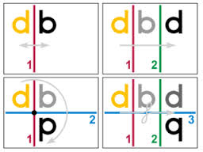
Big Idea
New Definition of Congruence with isometry

Slide 5
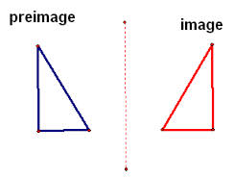
Preimage and image
Preimage is the original.
Image is the copied one.

Slide 6
Reflection

Slide 7
Rotation

Slide 8
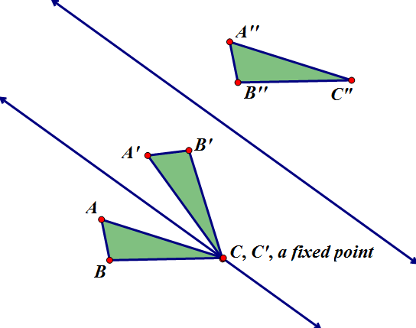
Translation
Any translation is a composition of two reflection over a pair of parallel lines.

Slide 9
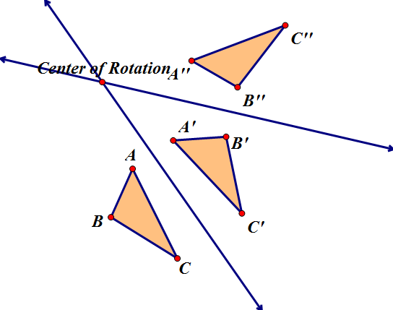
Theorem 7.1, part 1
Rotation is a composition of two reflection over intersecting lines.

Slide 10
Theorem 7.1b

Slide 11
Some other conjectures
There are at least one rotation in any figure.
The number of rotations and reflections of regular polygon is equal to the number of sides of the polygon.

Slide 12
Isometry/ Rigid Motion
Moving a figure without changing its shape and size by
Translation
Reflection
Rotation
Composition of transformation

Slide 13
Discussion Question
Q. When you reflect an object over a line, what properties of the object are present in its image?
A. Lengths and angle measures are preserved.

Slide 14
Discussion Question
Q. What happens when you compose two reflections? Three reflections? Four reflections?
A.
The composition of two reflections is a translation or a rotation;
The composition of three reflections is either a reflection or a transformation that reflects figures across a line and translates them parallel to the line of reflection;
The composition of four reflections is a translation or a rotation.

Slide 15
Problems
Problem 1-4 on page 589!

Slide 16
Are you ready for 7B?
If not, seek extra help before it’s too late!!
Summary video for 7A is available in my website.
In 7B, you will learn how to
Calculate the distance between two points with given coordinates
Calculate the coordinates of the midpoint of a segment
Prove algebraically that three points are or are not collinear
Recognize when two lines are parallel or perpendicular
Plot points in three dimensions and find the distance between them

