Slide 1
What were we doing in 6C?
Geometry Mathematical Reflection 6C

Slide 2
In this investigation,
You learned how to
Find the areas of cross sections of solids
Apply Cavalieri’s Principle
Prove basic formulas using Cavalieri’s Principle.

Slide 3
Vocabulary and Notation
NONE!!

Slide 4
Big Idea
Use Cavalieri’s Principle to prove volume formulas

Slide 5

Cavalieri’s Principle
$\text{Same} \text{heights}$
$\text{Same} \text{cross} \text{sectional} \text{areas}$
$\text{} \text{Same} \text{Volumes}$

Slide 6
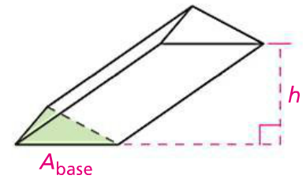

Theorem 6.3
$$V_{prism}=A_{base}∙h$$

Slide 7
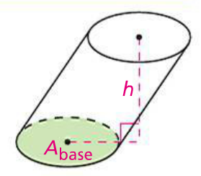

Theorem 6.4
$$V_{cylinder}=A_{base}∙h$$

Slide 8
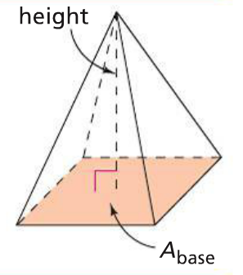

Theorem 6.5
$$V_{pyramid}=\frac{A_{base}∙h}{3}$$

Slide 9
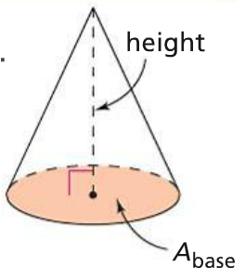

Theorem 6.6
$$V_{cone}=\frac{A_{base}∙h}{3}$$

Slide 10
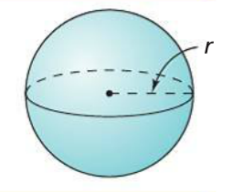

Theorem 6.7
$$V_{sphere}=\frac{4}{3}πr^{3}$$

Slide 11

Theorem 6.8
$${SA}_{sphere}=4πr^{2}$$

Slide 12
Discussion Question
Q.
A hexagonal pyramid of height $h$ is cut by a plane parallel to its base at height $r$ above the base. How is the shape of the resulting cross section related to the shape of the base of the pyramid? How are their areas related?
A.
The cross section is similar to the base; the area of the cross section is${\left(\frac{h−r}{h}\right)}^{2}$times the area of the base.

Slide 13
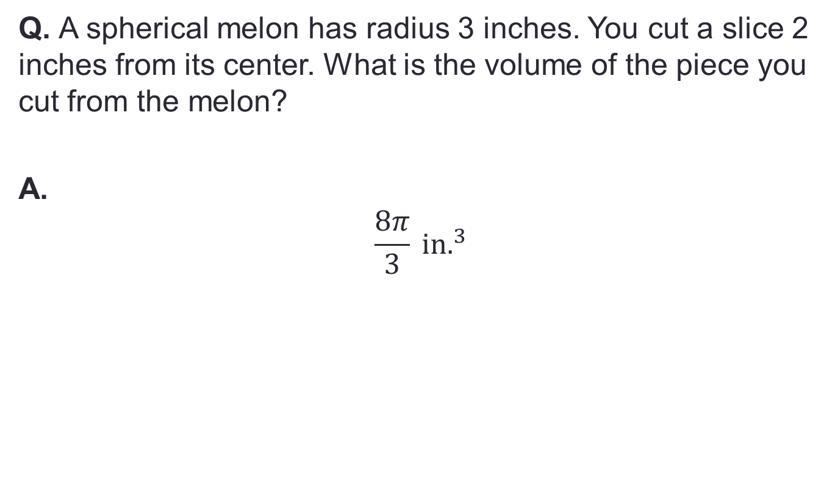
Discussion Question
Q. A spherical melon has radius 3 inches. You cut a slice 2 inches from its center. What is the volume of the piece you cut from the melon?
A.
$$\frac{8π}{3} in.^{3}$$

Slide 14
Problems
Problem 1-3 on page 540!

Slide 15
Are you ready for 6C?
If not, seek extra help before it’s too late!!
Summary video for 6C is available in my website.
In 7A, you will learn how to
Model reflections using paper-folding techniques
Model compositions of reflections and classify the resulting transformation as a reflection, rotation, translation, or combination of transformations.
Model rotations and translations in the plane, with and without coordinates
Understand properties of reflection, translation, and rotation in the plane\
Identify fixed points for a given transformation or composition of transformations
Use isometry to prove some triangle congruence criteria

