Slide 1
What were we doing in 6B?
Geometry Mathematical Reflection 6B

Slide 2
In this investigation,
You learned how to
Use trigonometric functions.
Find the areas, angle measures, and side lengths of triangles.
Use right triangles to solve problems.

Slide 3
Habits and Skills
You developed these habits and skills:
Find invariants in classes of right triangles.
Visualize right triangles in different problem situations.
Choose appropriate strategies to find missing angle measures and side lengths.

Slide 4

Vocabulary and Notation
Trigonometry
Sine, $\sin{θ}$
Cosine, $\cos{θ}$
Tangent, $\tan{θ}$
$\sin^{−1}{α}$
$\cos^{−1}{β}$
$\tan^{−1}{γ}$

Slide 5
Big Idea
Use trigonometry to find missing parts

Slide 6
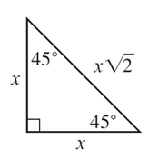
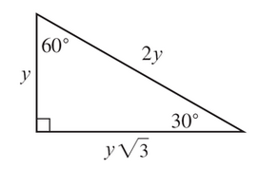
Special right triangles
One from a square
The other from an equilateral triangle

Slide 7
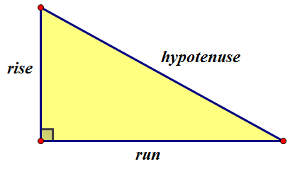

Sine, Cosine, Tangent
$$\sin{θ}=\frac{rise}{hypotenuse}, \cos{θ}=\frac{run}{hypotenuse},\tan{θ}=\frac{rise}{run}$$

Slide 8
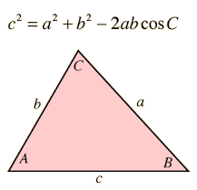
Law of Cosines

Slide 9
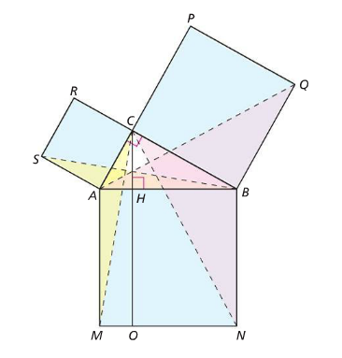
Do you remember this picture?

Slide 10
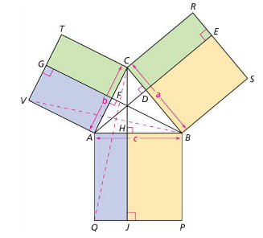
Do you understand this picture?

Slide 11
Discussion Question
Q. How can you use half of a square or half of an equilateral triangle to evaluate trigonometric functions for angle measuring $30°, 45°$ and $60°$?

Slide 12
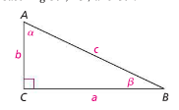
Discussion Question
Q. Find the sine, cosine, and tangelnt of $α$ and $β$ in terms of the side lengths of $ΔABC$.

Slide 13
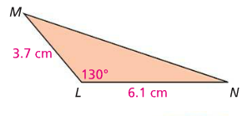
Discussion Question
Q. What is the area of $ΔLMN?$What is the approximate length of $\overline{MN}$?

Slide 14
Problems
Problem 1-3 on page 510!

Slide 15
Are you ready for 6B?
If not, seek extra help before it’s too late!!
Summary video for 6B is available in my website.
In 6B, you will learn how to
Find the areas of cross sections formed when planes intersect with solids under certain conditions
Understand and use Cavalieri’s Principle
Prove basic volume formulas using Cavalieri’s Principle

