Slide 1
What were we doing in 5A?
Geometry Mathematical Reflection 5A

Slide 2
In this investigation,
You explored ways to find the perimeters and areas of shapes with curved edges.

Slide 3
Habits and Skills
You developed these habits and skills:
Visualize the effect of a finer mesh on area approximation or smaller segments on perimeter approximation.
Determine the effect of scaling on the area of a figure.
Relate areas and perimeters of regular polygons with increasing numbers of sides to the area and circumference of a circle.

Slide 4
DHoM
Strategize
Use shortcuts whenever possible
Detect the key characteristics

Slide 5
Vocabulary and Notation
Apothem
Circumscribe
Inscribe
Limit
Linear approximation
$a_{n}→r(a_{n} approaches r)$

Slide 6
Big Idea
Use smaller squares to estimate the area of a curved shape more precisely.
Use shorter segments to estimate the perimeter of a curved shape more precisely.
Theorem 5.1 and 5.2

Slide 7
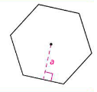
Apothem
The length of the perpendicular segment from the center point of the polygon to one of its sides.

Slide 8
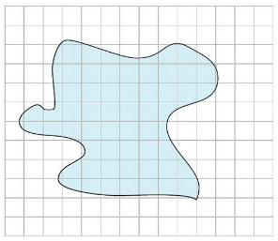
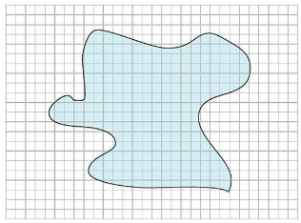
Smaller squares to estimate the area of a blob more precisely

Slide 9
Smaller segments to estimate the perimeter of a blob more precisely

Slide 10
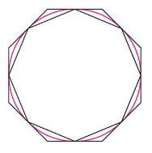
Inscribed and Circumscribed polygons

Slide 11
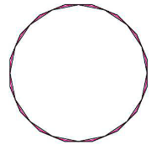
Limit
The inner perimeter and outer perimeter gets closer and closer to a single number
The inner sum and outer sum gets closer and closer to a single number.

Slide 13
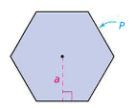
Theorem 5.1
$A=\frac{1}{2}Pa,$
$P is Perimeter, a is apothem$

Slide 14
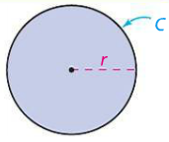
Theorem 5.2
$A=\frac{1}{2}Cr$
$C is circumference, r is radius$

Slide 15
Discussion Question
Q. How can you calculate the area of a blob?
Ans.
Use a grid with smaller squares and count squares.

Slide 16
Discussion Question
Q. What is the circumference of a circle?
Ans.
The distance around the circle

Slide 17
Discussion Question
Q. What formula relates the area of a circle to its circumference?
Ans.
$A=\frac{1}{2}Cr$

Slide 18
Problems
Problem 1-5 on page 373!

Slide 19
Are you ready for 5B?
If not, seek extra help before it’s too late!!
Summary video for 5B is available in my website.
In 5B, you will learn how to
Use the definition of $π$ as the area of the unit circle
Develop and use the formula $A=πr^{2}$
Develop and use the formula $C=2πr$

