Slide 1
What were we doing in 4D?
Geometry Mathematical Reflection 4D

Slide 2
In this investigation,
You studied similar figures.
You used the AA, SAS, and SSS tests to determine whether two triangles are similar.
You also used scale factors to find the areas of two similar figures.

Slide 3
Habits and Skills
You developed these habits and skills:
Visualize similar triangles.
Look for invariant ratios.
Make logical inferences to prove similarity.

Slide 4
DHoM
Consider the converse
Think it through
Simplify
Prove a special case

Slide 5
Vocabulary and Notation
Similar figures
∼ (is similar to)

Slide 6
Big Idea
Similar figures mean figures with:
Congruent corresponding angles
Proportional corresponding sides.
3 Tests for similarity
AA Similarity Test
SAS Similarity Test
SSS Similarity Test

Slide 7
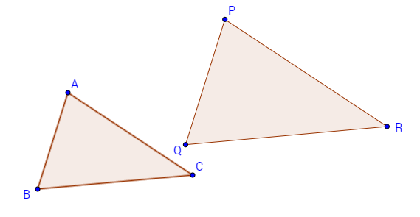
Similar figures
$$\frac{AB}{PQ}=\frac{BC}{QR}=\frac{CA}{RP}, ∠A≅∠B≅∠C$$

Slide 8
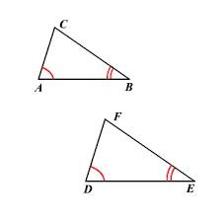
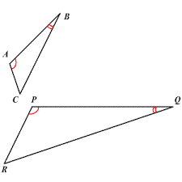
AA Similarity Test
Check two corresponding angles. If they are congruent, then two triangles are similar.

Slide 9
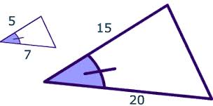
SAS Similarity Test
Check two corresponding sides and a corresponding angles.
If two corresponding sides are proportional, and corresponding angles are congruent, then they are similar.

Slide 10
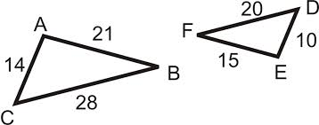
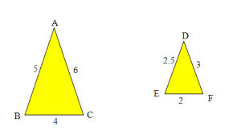
SSS Similarity Test
Check three corresponding sides.
If all of the are proportional, they are similar.

Slide 11
Discussion Question
Q. What does it mean for two figures to be similar?
Ans.
One figure is a scaled copy of the other.

Slide 12
Discussion Question
Q. What are some tests for triangle similarity?
Ans.
AA Similarity Theorem
SAS Similarity Theorem
SSS Similarity Theorem

Slide 13
Discussion Question
Q. If the common ratio of two similar figures is $r,$what is the ratio of their areas?
Ans.
$r^{2}$

Slide 14
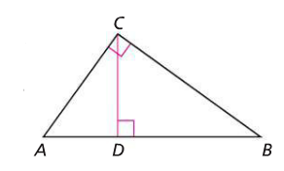
Problem 1
In the figure at the right, suppose $\overline{CD}⊥\overline{AB}$. How many similar triangles can you find? Prove that all the ones you find are similar. Use the triangle similarity tests.

Slide 15
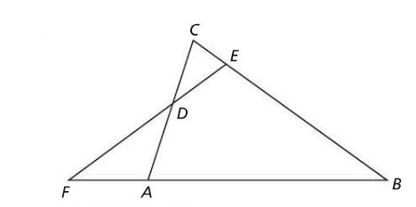
Problem 2
In the figure at the right, $ΔABC∼ΔEDC.$ Prove $ΔFDA∼ΔFBE.$

Slide 16
Problem 3
In quadrilateral, $EFGH, \overline{EF}∥\overline{HG}, \overline{EH}⊥\overline{EF}, EF=6, FG=5, GH=10,$ and $EH=3.$
Find the area of $EFGH.$
Scale $EFGH$ by 3. Call the scaled copy $IJKL,$ so that $EFGH∼IJKL.$ Find the area of $IJKL$.
What is the ratio of the areas of $EFHG$ and $IJKL?$

Slide 17
HOMEWORK!!
Homework 4D is due on Friday, Dec. 1/16.
Homework Session for 4D is
For Period 2-3 is on Period 7 Thursday 1/15.
For Period 5-6 is on 1/15 .

Slide 18
Are you ready for 5A?
If not, seek extra help before it’s too late!!
Summary video for 4D is available in my website.
In 5A, you will learn how to
Approximate areas of closed curves with inner and outer sums
Approximate perimeters of closed curves with linear approximation
Establish that the area of a regular polygon is $\frac{1}{2}$ the perimeter times the apothem
Approximate areas and perimeters of circles with inscribed and circumscribed regular polygons.

