Slide 1
What were we doing in 4C?
Geometry Mathematical Reflection 4C

Slide 2
In this investigation,
You explored parallels and proportions in nested triangles.
You proved the side-splitter theorems.

Slide 3
Habits and Skills
You developed these habits and skills:
Use ratios and proportions.
Prove conjectures using scaled figures.
Identify invariants.

Slide 4
DHoM
Understand the process (pg 313)
Make connections (pg 315)

Slide 5
Vocabulary and Notation
Common ratio
Nested triangles
Splits two sides proportionally

Slide 6
Big Idea
“Ratio” means to compare and tell how many times as big or as long.
“Proportionally” means to have the same ratio.

Slide 7
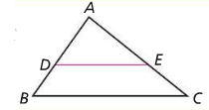
Definitions
$$In ΔABC, \overline{DE} splits two sides proportionally$$
$$⇔\frac{AB}{AD}=\frac{AC}{AE},\frac{AB}{AD}is the common ratio.$$

Slide 8
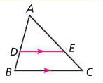
The Parallel Side-Splitter Theorem
$\overline{DE}//\overline{BC} \text{⇒} \frac{AD}{AB}=\frac{AE}{AC}=\frac{DE}{BC}$

Slide 9
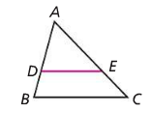
The Proportinal Side-Splitter Theorem
$\frac{AD}{AB}=\frac{AE}{AC} \text{⇒}$ $\overline{DE}//\overline{BC}$

Slide 10
Discussion Question
Q. What is the mathematical meaning of dilation?
Ans.
The process of expanding or shrinking a figure without changing its shape.

Slide 11
Discussion Question
Q. If a point $D$ is on side $\overline{AB}$ of $ABC$, $E$ is on $\overline{AC},$ and $\overline{DE}$ is parallel to $\overline{BC},$ then what can you say about the relationship between $ABC$ and $ADE$
Ans.
The are scaled copies of each other.

Slide 12
Discussion Question
Q. What are the side-splitter theorem?
Ans.
The Proportional Side-Splitter Theorem says that is a segment with endpoints on two sides of a triangle splits those sides proportionally, then it is parallel to the third sides.
The Parallel Side-Splitter Theorem says that if a segment that splits two sides of a triangle is parallel to the third side, then it splits the two sides proportionally.

Slide 13
Discussion Question
Q. If two triangles have the same height, and you know the ratio of their areas, what is the ratio of the lengths of their bases?
Ans.
The same as the ratio of the areas.

Slide 14
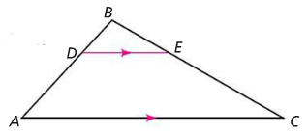
Problem 1
$$In ΔABC, \overline{DE} ǁ \overline{AC}, DB=\frac{1}{3}AB, AB=6, BE=3, and AC=12.$$
$$What are BC, DE, and DB?$$

Slide 15
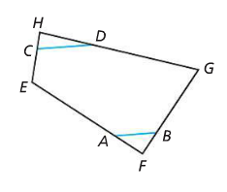
Problem 2
$$EFGH is a quadrilateral. CH=\frac{1}{3}HE, HD=\frac{1}{3}HG,$$
$$AF=\frac{1}{4}EF, and BF=\frac{1}{4}FG. Prove that \overline{AB} ǁ \overline{CD}.$$

Slide 16
Problem 3
Use the side-splitter theorems to prove the Midline Theorem.

Slide 17
Problem 4
$$Suppose you want to scale a segment, \overline{AB},$$
$$by the factor\frac{1}{3} and use a point O not on \overline{AB}$$
$$as the center of dilation. Describe each step$$
$$you would use.$$
$$Give a reason for each step.$$

Slide 18
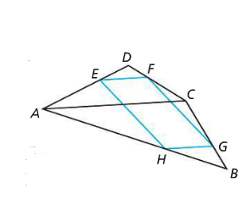
Problem 5
$$In the diagram at the right, AD=24,$$
$$ED=8, DC=21, and DF=7. HBG is a$$
$$scaled copy of ABC such that its area$$
$$is\frac{1}{9}the are of ΔABC. Prove that EFGH is a$$
$$parallelogram.$$

Slide 19
HOMEWORK!!
Homework 4C is due on Friday, Dec. 1/16.
Homework Session for 4C is
For Period 2-3 is on Period 7 Thursday 1/15.
For Period 5-6 is on 1/15 .

Slide 20
Are you ready for 4B?
If not, seek extra help before it’s too late!!
Summary video for 4B is available in my website.
In 4B, you will learn how to
Describe and use methods for constructing enlargements or reductions of shapes
Explain and contrast the ratio method and parallel method for dilation
Identify parallel segments and corresponding segments in a drawing and its scaled copy

