Slide 1
What were we doing in 4B?
Geometry Mathematical Reflection 4B

Slide 2
In this investigation,
You explored dilations.
You applied scale factors to construct enlargements and reductions.
You explored choices for the center of dilation.
You learned the ratio and parallel methods.

Slide 3
Habits and Skills
You developed these habits and skills:
Identify a dilation as an enlargement or reduction by looking at the scale factor.
Dilate figures using the ratio method and parallel method.
Describe the effects of the choice for center of dilation on the resulting dilation.

Slide 4
DHoM
Communicate context
Make strategic choices
Check your results

Slide 5
Vocabulary and Notation
Center of dilation
Dilation
Parallel method
Ratio method

Slide 6
Big Idea
How can you tell if it is a scaled(good) copy?
The lengths of corresponding sides are proportional.
The corresponding angles are congruent.
To dilate a figure, you have two methods
The Ratio Method
The Parallel Method

Slide 7
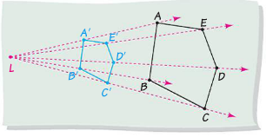
The Ratio Method
Draw a ray from the center of dilation to each vertex
Scale each segment by a scale factor
Plot points on each segment
Connect points to form scaled figure

Slide 8
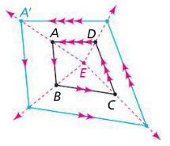
The Parallel method
Draw a ray from a point inside a polygon to each vertex
Along ray, find a point.
Start at a point. Draw segments parallel to each side of the polygon

Slide 9
Discussion Question
Q. What is the mathematical meaning of dilation?
Ans.
The process of expanding or shrinking a figure without changing its shape.

Slide 10
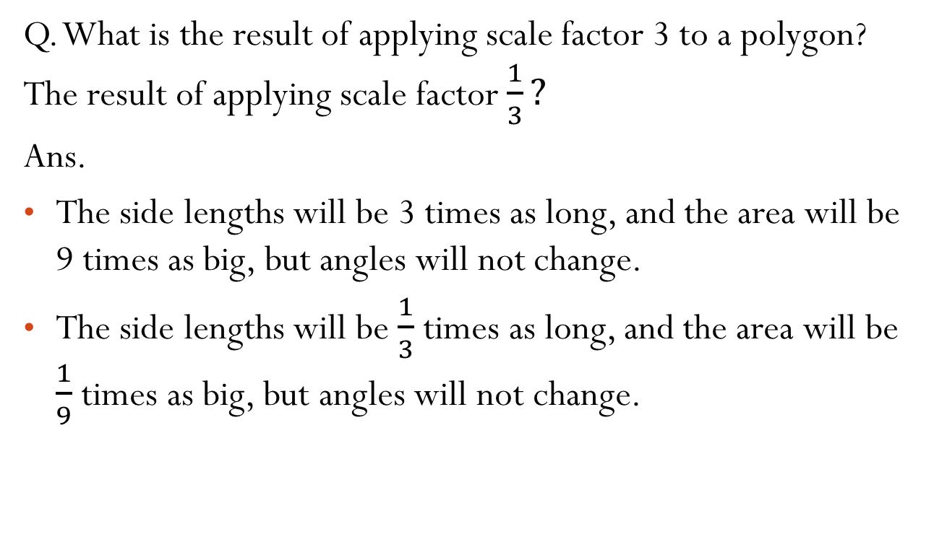
Discussion Question
Q. What is the result of applying scale factor 3 to a polygon? The result of applying scale factor $\frac{1}{3}?$
Ans.
The side lengths will be 3 times as long, and the area will be 9 times as big, but angles will not change.
The side lengths will be $\frac{1}{3}$ times as long, and the area will be $\frac{1}{9}$ times as big, but angles will not change.

Slide 11

Problem 1
You scale a figure by the factor $\frac{3}{5}.$ How do the areas of the original figure and the scaled copy compare?

Slide 12

Problem 2
Draw $ABC$ and point $X$ outside of $ABC$. Use the ratio method or parallel method. Scale $ABC$ by $\frac{2}{3}.$ Use the $X$ as the center of dilation.

Slide 13
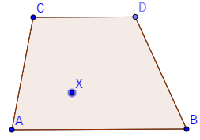
Problem 3
Draw polygon $ABCD$ and point $X$. Use the parallel method. Dilate $ABCD$ by the factor $\frac{1}{5}$. Use $X$ as the center of dilation.

Slide 14
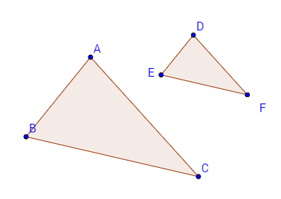
Problem 4
Explain how to find the center of dilation that maps $ABC$ to $DEF$.

Slide 15
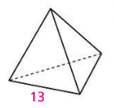
Problem 5
If you scale the regular tetrahedron at the right by the factor 2, how do the surface areas of the original figure and the scaled copy compare?

Slide 16
HOMEWORK!!
Homework 4A is due on Friday, Dec. 12/19.
Homework Session for 4A is
For Period 2-3 is on Tuesday 12/16.
For Period 5-6 is in Period 7 on 12/18.

Slide 17
Are you ready for 4B?
If not, seek extra help before it’s too late!!
Summary video for 4B is available in my website.
In 4B, you will learn how to
Describe and use methods for constructing enlargements or reductions of shapes
Explain and contrast the ratio method and parallel method for dilation
Identify parallel segments and corresponding segments in a drawing and its scaled copy

