Slide 1
What were we doing in 4A?
Geometry Mathematical Reflection 4A

Slide 2
In this investigation,
You studies scaled copies – Accurate reductions or enlargements of given figures.
You used scale factors to draw similar figures and to approximate distances on blue prints and maps.
You also studied ways to decide whether two shapes were well-scaled copies of each other.

Slide 3
Habits and Skills
You developed these habits and skills:
Identify scaled copies of figures.
Use a scale factor to approximate distances on blueprints and maps.
Apply a scale factor to make similar figures.

Slide 4
DHoM
Visualize
Understand context
Simplify

Slide 5
Vocabulary and Notation
Ratio
Scale a figure
Scaled figure
Scale factor

Slide 6
Big Idea
“Well-scaled copies” mean good copies.
A good copy is bigger or smaller copy all around.
Scaling a figure by a scale factor, $r$, means to multiply by $r$ all around so that the new figure is proportional.

Slide 7
How do you know two figures are scaled?
By eye
By measurement
By test with angles for triangles
By test with diagonals for rectangles
By the test with segments between pairs of vertices

Slide 8
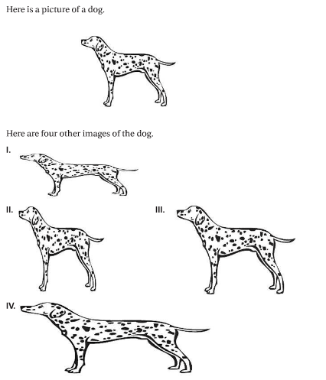
By Eye

Slide 9
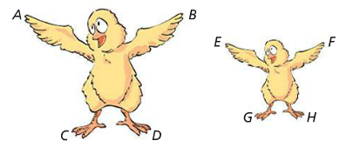
By Measurement
Scale factor must be the same for all pairs!

Slide 10
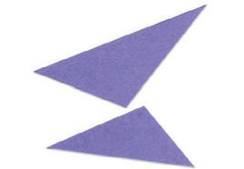
Test with angles
Conjecture: If two triangles have congruent corresponding angles, then the triangles are scaled copies.
Why? We will prove this conjecture in 4D.

Slide 11
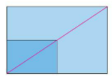
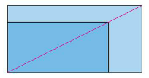
Test with diagonals
Conjecture: If diagonals of two rectangles match up, then two rectangles are scaled.

Slide 12
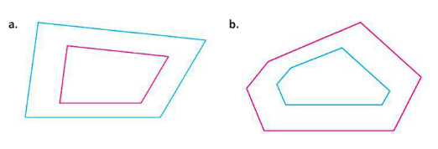
Test with segments between pairs of vertices
Does a pair of corresponding angles overlap perfectly?
Do segment line up?
Are pair(s) of segments parallel?

Slide 13
Discussion Question
Q. Why is it important to know the scale factor when reading a map?
A. The scale factor tells how map distances relate to actual distances.

Slide 14
Discussion Question
Q. What is a well-scaled drawing?
A. A drawing that preserves all ratios and relative positions of the original figure.

Slide 15
Discussion Question
Q. How can you decide whether two rectangles are scaled copies of each other?
A. Check whether the ratio of their lengths equals the ratio of their width.

Slide 16
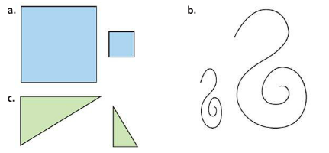
Problem 1
Give an approximate scale factor for the following pairs of figures. If you think that the figures are not scaled copies of each other, explain why.

Slide 17
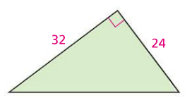
Problem 2
Scale the triangle at the right by the factor $\frac{1}{4}.$

Slide 18
Problem 3
Check, without measuring, whether the two rectangles below are scaled copies of each other. Explain.

Slide 19
HOMEWORK!!
Homework 4A is due on Friday, Dec. 12/19.
Homework Session for 4A is
For Period 2-3 is on Tuesday 12/16.
For Period 5-6 is in Period 7 on 12/18.

Slide 20
Are you ready for 4B?
If not, seek extra help before it’s too late!!
Summary video for 4B is available in my website.
In 4B, you will learn how to
Describe and use methods for constructing enlargements or reductions of shapes
Explain and contrast the ratio method and parallel method for dilation
Identify parallel segments and corresponding segments in a drawing and its scaled copy

