Slide 1
What were we doing in 3D?
Geometry Mathematical Reflection 3D

Slide 2
In this investigation,
You found lateral surface area and total surface area of solids by visualizing their nets.
You also used formulas to calculate volumes.

Slide 3
Habits and Skills
You developed these habits and skills:
Visualize a net for a three-dimensional object.
Understand surface area and volume.
Reason by continuity to connect formulas.

Slide 4
DHoM
Visualize
Generalize
Make and verify a conjecture

Slide 5
Vocabulary and Notation
Apex
Base
Circumference
Cone
Cylinder
Face
Frustum
Lateral face
Lateral surface
Lateral surface area
Oblique prism
Oblique pyramid
Perimeter
Polyhedron
Pyramid
Right pyramid
Slant height
Surface area
Volume

Slide 6
Big Idea
The shape of lateral faces of
right prisms are rectangles.
right pyramids are triangles.
Total surface areas are the areas of all faces
Volume is the number of cubes that you can fit in a space.

Slide 7
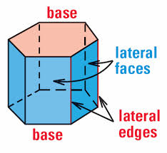
Lateral Surface Area
The area of all faces except bases

Slide 8
Pyramids

Slide 9
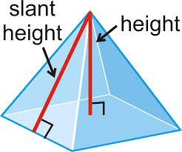
Slant height and height
Height is the distance from apex to the base
Slant height is the height of the face

Slide 10
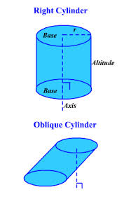
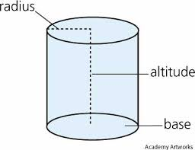
Cylinder

Slide 11
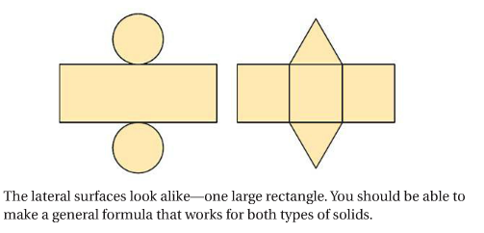
Lateral surface area (LA)
Is the product of the perimeter and its height
$LA=Ph$

Slide 12
Cones

Slide 13
The simplified formulas for LA
Right prisms and cylinders:
$LA = Ph$
Right pyramids and cones:
$LA=\frac{1}{2}Pl, where l is the slant height$

Slide 14
Volumes of Solids
Volume is the number of cubes that can fits inside.
Volume of a Prism or Cylinder
$V=Bh, where B is the base area$
Volume of a Pyramid or Cone
$V=\frac{1}{3}Bh, where B is the base area$

Slide 15
Discussion Question
How can you use perimeter and area of two-dimensional shapes to find surface area and volume of three- dimensional solids?
For prisms, and cylinders, use the product of the height of the solid and the perimeter of the base to calculate the lateral area. Add the areas of the bases to the product to calculate total surface area.

Slide 16
Discussion Question
What is the relationship between a prism and a cylinder? Between a pyramid and a cone?
A regular prism with a very large number of sides resembles a cylinder.
A regular pyramid with a very large number of sides resembles a cone.

Slide 17
Problem 1
A cylinder and a cone have the same base. The height of each is equal to the radius of its base. What is the ratio of their lateral surface areas?

Slide 18
Problem 2
Draw a net for the regular tetrahedron shown below.

Slide 19
Problem 3
What is the total surface area of a cylinder with diameter 108 cm and height 18cm?

Slide 20
Problem 4
Two cones have slant height 8 in. The first cone has a radius of 4 in. The second cone has a diameter of 12 in. What is the ratio of their lateral surface areas?

Slide 21
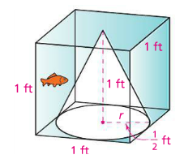
Problem 5
Stephanie has a goldfish who lives in a tank like the one shown at the right. The cone juts up into the tank to give the fish something to swim around. How much water does Stephanie need to fill the tank? (Disregard the volume of the fish.)

Slide 22
Are you ready for 4A?
In 4A, you will learn how to
Approximate the scale factor relating two pictures by measuring
Use a given scale factor to interpret a map or blueprint
Decide whether two figures are well-scaled copies of each other
Don’t forget HOMEWORK!!

