Slide 1
What were we doing in 3B?
Geometry Mathematical Reflection 3B

Slide 2
In this investigation,
You formalized the ideas of cutting and rearranging.
You derive and prove the area formulas for triangles, parallelograms, and trapezoids.

Slide 3
Habits and Skills
Visualize ways to make equal-area figures through dissection.
Write clear and precise algorithms
Reason by continuity to identify extreme cases.

Slide 4
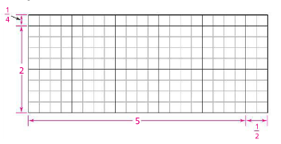
DHoM
Use Multiplication to Count

Slide 5
Vocabulary and Notation
Base
Height

Slide 6
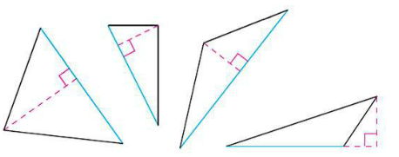
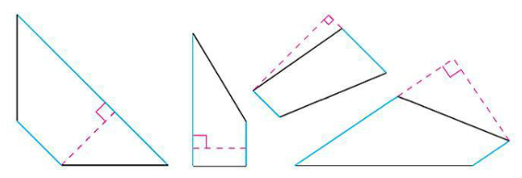
Base and Height
Base doesn’t have to be horizontal.

Slide 7
Big Idea
We know we can dissect any parallelogram, any triangle, and any trapezoid to a rectangle.
We know how to find the area of rectangle.
Then, we know how to find the areas of any parallelogram, any triangle, and any trapezoid to a rectangle.

Slide 8
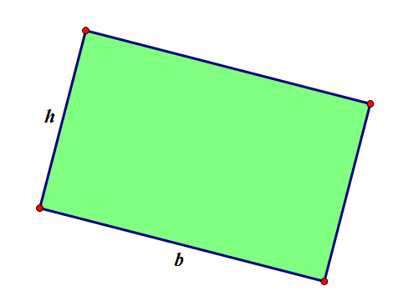
Area of a Rectangle
Is “base times height”
or $A=bh.$

Slide 9
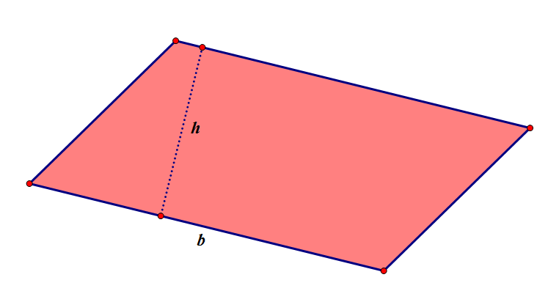
Area of a Parallelogram
Is “base times height”
or $A=bh.$

Slide 10
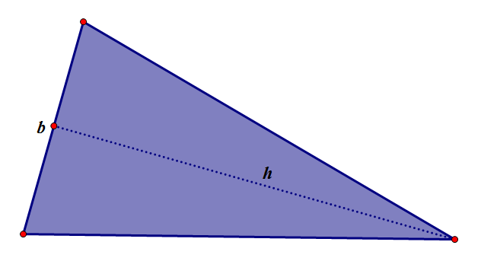
Area of a Triangle
“base times half of the height”
or $A=\frac{1}{2}bh$

Slide 11
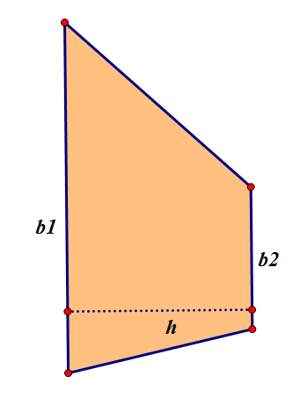
Area of a Trapezoid
“base 1 plus base 2, then the sum times half of the height”
or $A=\frac{1}{2}(b_{1}+b_{2})h$

Slide 12
List of Area Formula
$A_{rectangle}=bh$
$A_{parallelogram}=bh$
$A_{triangle}=\frac{1}{2}bh$
$A_{trapezoid}=\frac{1}{2}\left(b_{1}+b_{2}\right)h$
Do you understand where these formulas come from?

Slide 13
Discussion Question
If two figures are scissors-congruent, do they have the same area? Explain.

Slide 14
Discussion Question
Are all squares with the same area congruent?

Slide 15
Discussion Question
What is the area formula for a parallelogram? For a triangle? For trapezoid?

Slide 16
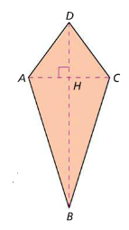
Problem 1
In kite ABCD at the right, $AC=3cm, DH=2cm,$ and $BH=5 cm.$ What is the area of ABCD?

Slide 17
Problem 2
Two triangles have equal areas. Does this mean that they are congruent? Explain with an example.

Slide 18
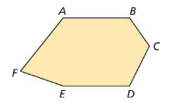
Problem 3
In hexagon $ABCDEF,$ $\overline{AB}$ and $\overline{DE}$ are congruent and parallel. Also $\overline{AE}⊥\overline{DE}.$ Is hexagon $ABCDEF$ scissors-congruent to a rectangle? If so, write down the steps that are necessary for dissecting it into a rectangle.

Slide 19
Problem 4
You dissect a parallelogram with area 32 into a square. What is the side length of the square?

Slide 20
Problem 5
Can two parallelograms with base lengths of 34 and 53 have the same area? If so, describe how.

Slide 21
Are you ready for 3C?
In 3C, you will learn how to
Build a formal proof of the Pythagorean Theorem
Find lengths of sides of right triangles
Analyze proofs of the Pythagorean Theorem
Don’t forget HOMEWORK!!

