Slide 1
What were we doing in 3A?
Geometry Mathematical Reflection 3A

Slide 2
In this investigation,
You used
Dissection to make scissors-congruent shapes.
The Midline Theorem

Slide 3
Habits and Skills
Visualize ways to make equal-area figures through dissection.
Write clear and precise algorithms
Reason by continuity to identify extreme cases.

Slide 4
DHoM
Make a list
Listing all properties help you notice things you might otherwise overlook.

Slide 5
Vocabulary and Notation
Algorithm
Hypotenuse
Scissors-congruent

Slide 6
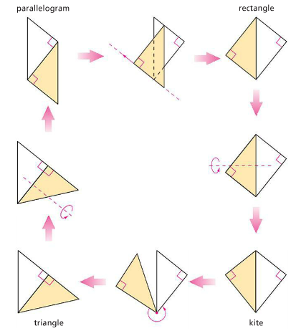
Scissors-congruent
Cut a figure into pieces
Use all pieces you cut to rearrange to make a different figure.

Slide 7
Theorem 3.1

Slide 8
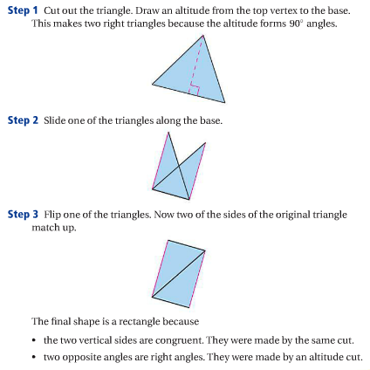
Algorithm
Is a set of steps to a completely determined result.

Slide 9
The Midline Theorem

Slide 10
Discussion Question
What is an algorithm?

Slide 11
Discussion Question
Why is it important to justify each step in an algorithm?

Slide 12
Discussion Question
What does the Midline Theorem say about the relationship between a midline and the sides of a triangle?

Slide 13
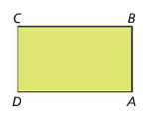
Problem 1
Describe and justify each step in the dissection that turns any parallelogram into a rectangle.

Slide 14
Problem 2
Describe how you would dissect this rectangle into a right triangle. Justify each step. Draw pictures as needed.

Slide 15
Problem 3
Is it possible to dissect each of thse triangles into a parallelogram? If you think it is possible in either or both of the cases, describe the steps.

Slide 16
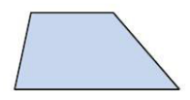
Problem 4
Copy and dissect the trapezoid at the right into a triangle.

Slide 17
Problem 5
Draw $ABC$. Join the midpoints of its three sides to form $DEF.$ What is the ratio of the perimeter of $DEF$ to the perimeter of $ABC$?

Slide 18
Are you ready for 3B?
In 3B, you will learn how to
Understand and apply basic assumptions about area.
Identify critical measurements that can be used to find the areas of different types of polygons.
Use dissection algorithms to develop area formulas for parallelograms, triangles, and trapezoids.
Don’t forget HOMEWORK!!

