Slide 1
Chapter Test 3 Prep
CME Geometry
Mr. Tanaka

Slide 2
In 3A, you learned how to
Change one shape into another by making cuts and rearranging the parts
Tell when two shapes are scissors-congruent
Prove the Midline Theorem using cuts and rearrangement

Slide 3
Problem 1
Describe an algorithm for dissecting this trapezoid into a rectangle.

Slide 4
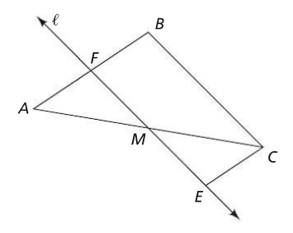
Problem 2
In the figure below, M is the midpoint of $\overline{AC}, l ǁ \overline{BC},$and $EM=MF$. Prove each statement.
$\overline{EC} ǁ \overline{AB}$
$BCEF$ is a parallelogram
$FM=\frac{1}{2}BC$

Slide 5
In 3B, you learned how to
Calculate the area of a parallelogram, of a triangle, and of a trapezoid
Prove the formulas for calculating the areas above
Tell the difference between two figures being scissors-congruent and having the same area

Slide 6
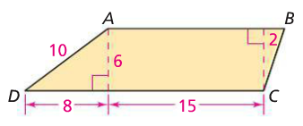
Problem 3
In trapezoid $ABCD, \overline{AB} ǁ \overline{CD}.$ What is the area of trapezoid $ABCD$?

Slide 7
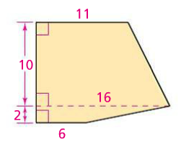
Problem 4
What is the area of this pentagon?

Slide 8
Problem 5
If two rectangles have the same area, are they scissors-congruent? Explain.

Slide 9
In 3C, you learned how to
Follow the logical reasoning and fill in missing steps in proofs of the Pythagorean Theorem
Identify the critical features in a proof without words
See where and how to use the Pythagorean Theorem to find missing lengths in figures

Slide 10
Problem 6
Write your favorite proof of the Pythagorean Theorem.

Slide 11
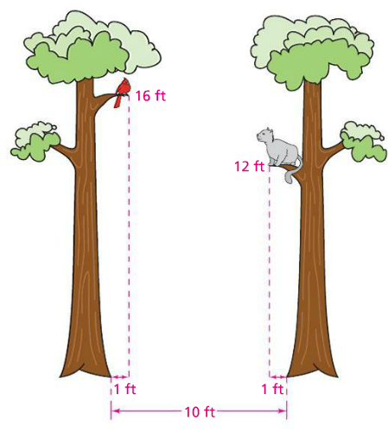
Problem 7
How far is the cat from the birds?

Slide 12
Problem 8
Draw two parallel lines $l$ and $m$ that are 3 in. apart. Choose point $A$ on line $l$ and line $n$ through point $B$ on line $m$ such that $AB=5$ in. Draw line $n$ through point $B$ and perpendicular to line $m.$ Let $C$ be the intersection of lines $l$ and $n$. How far is $C$ from $A$?

Slide 13
In 3D, you learned how to
Find the surface area of solids by visualizing their nets
Estimate the volumes of solids
Use formulas for the volumes of certain solids

Slide 14
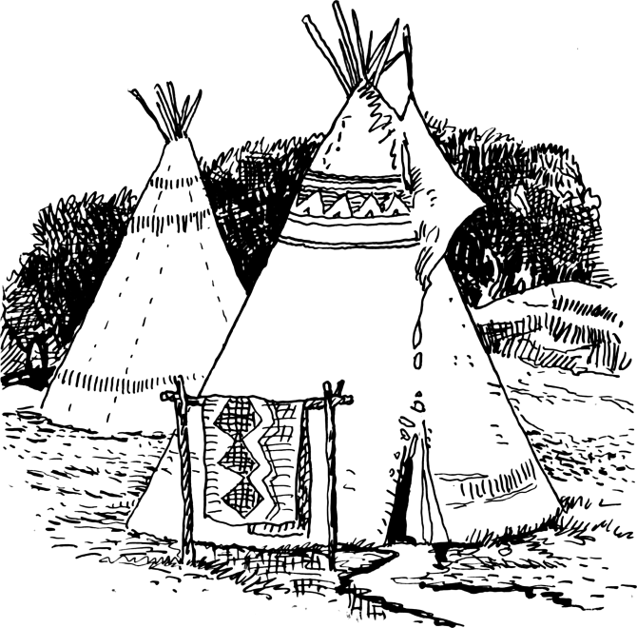
Problem 9
A friend of yours has made a replica of a traditional Sioux tepee, and she needs to know its volume. Suppose the inside of her tepee is a cone of radius 4m, with slant height 8 m. What is the approximate volume of the tepee?

Slide 15
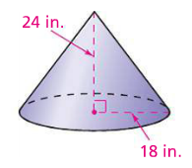
Problem 10
What is the total surface area of the cone shown below?

Slide 16
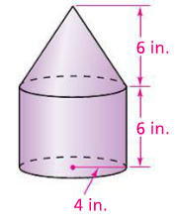
Problem 11
What is the volume of the solid below?

