Slide 1
Review: Chapter Test 2
CME Geometry

Slide 2
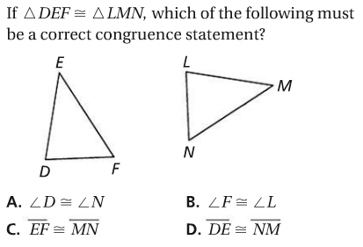
Problem 1

Slide 3
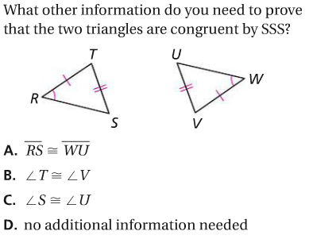
Problem 2

Slide 4
Problem 3

Slide 5
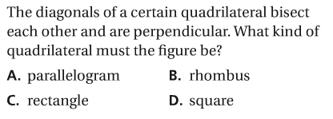
Problem 4

Slide 6
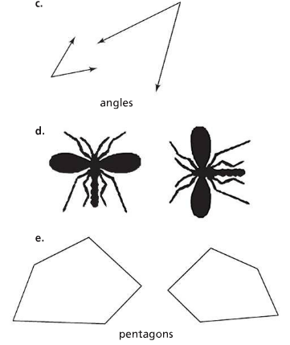
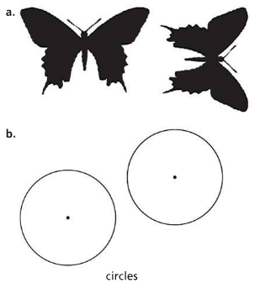
Problem 5
For each pair, decide whether the two figures are congruent. Explain your reasoning.

Slide 7
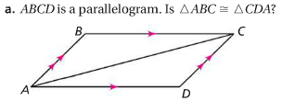
Problem 6a
For each diagram, use the given information. Determine whether the two triangles are congruent. If they are congruent, prove it using the triangle congruence postulates.

Slide 8
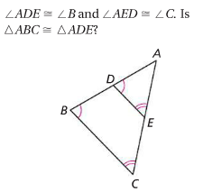
Problem 6b
For each diagram, use the given information. Determine whether the two triangles are congruent. If they are congruent, prove it using the triangle congruence postulates.

Slide 9
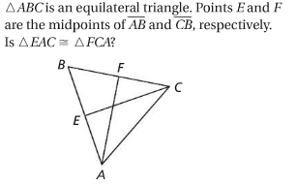
Problem 6c
For each diagram, use the given information. Determine whether the two triangles are congruent. If they are congruent, rove it using the triangle congruence postulates.

Slide 10
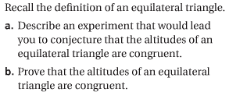
Problem 7

Slide 11
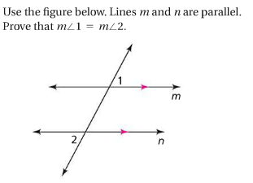
Problem 8

Slide 12
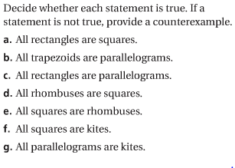
Problem 9

Slide 13
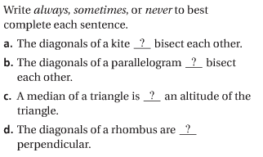
Problem 10

Slide 14
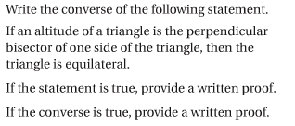
Problem 11

