Slide 1
Preview Chapter Test 1
CME Geometry

Slide 2
Problem 1
In your own words, describe the meaning of collinear.

Slide 3

Problem 2
Use the segment below. Construct a square with sides of length $a$

Slide 4
Problem 3
Construct each triangle to meet the specifications. If you cannot construct the triangle, explain why.
Side lengths: 2 in., 2 in., 5 in.
Side lengths: 3 cm., 5 cm., 6 cm.
Angle measures: $55,65,$ $75$
Angle measures: $45,45,$ $90$

Slide 5
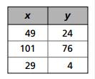
Problem 4
Use the table
Describe the invariant relationship between $x$ and $y$ in the table
List three more pairs of numbers $(x, y)$ that fit this invariant relationship.
Can $x$ or $y$ have a negative value in this relationship? Explain
Can $x=0$ in this relationship? Can $y=0$ in this relationship?

Slide 6
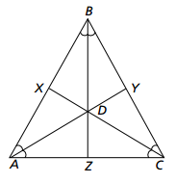
Problem 5
Use the figure below
Describe any concurrences.
Describe any collinearities.
Describe the triangle.
What type of triangle is this?
Describe the segments.
What are $\overline{BZ,}\overline{AY,}$ and $\overline{CX.}$

Slide 7
Problem 6
To construct a perpendicular line with geometry software, which pieces of information do you need? Explain.
To construct an equilateral triangle with geometry software, which pieces of information do you need? Explain.

Slide 8
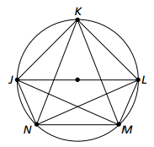
Problem 7
The figure shows several angles inscribed in a circle. From the list below, identify angles that have the same measure.

Slide 9
Problem 8
Construct a square with at least one side 5 inches long.
Construct a rectangle with at least one side 5 inches long, and with more area than the square from part (a).

Slide 10
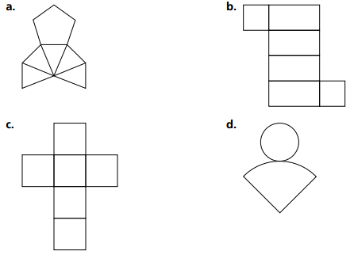
Problem 10
Name the solid that you can make by folding each figure.

