Slide 1
What were we doing in 2d?
Geometry Mathematical Reflection 2D

Slide 2
In this investigation,
You studied
different types of quadrilaterals, such as kites and trapezoids,
The characteristics of the special types of parallelograms – rectangles, rhombuses, and squares.

Slide 3
Habits and Skills
Characterize sets in a give class.
Understand that the converse of a statement is not automatically true when the initial statement is true.
Reason by continuity.

Slide 4
DHoM
Check your work
How can you be sure?
Communicate a conditional situation
If A, then B

Slide 5
Vocabulary and Notation
Base angle
Base of a trapezoid
Closed figure
Concave
Isosceles trapezoid
Kite
Parallelogram
Quadrilateral
Rectangle
Rhombus
Self-intersecting figure
Side
Skew quadrilateral
Square
Trapezoid
Trisected
Vertex/ vertices

Slide 6
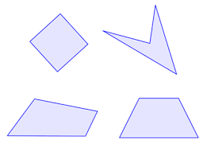
General Quadrilateral
Definition
4 segments
The sides intersect at their endpoints.
Each vertex is the endpoint of exactly two sides.

Slide 7
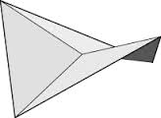
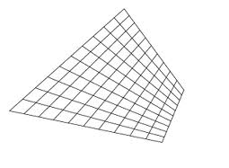
Skew Quadrilaterals
A Quadrilateral that lie in two planes

Slide 8
Self-intersecting Quadrilaterals
A quadrilateral that the sides intersect each other.

Slide 9
Concave (Nonconvex) Quadrilaterals
A quadrilateral with at least one diagonal outside the quadrilateral.

Slide 10
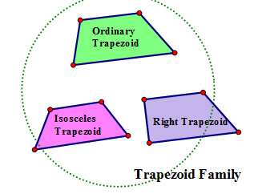
Trapezoids
Definition
A quadrilateral with exactly one pair of parallel sides.

Slide 11
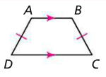
Isosceles Trapezoid
A trapezoid with opposite nonparallel sides are congruent.

Slide 12
Kite
Definition
A quadrilateral in which
Two adjacent sides are congruent, and
The other two adjacent sides are congruent.

Slide 13
Parallelogram
Definition
A quadrilateral with two pairs of opposite parallel sides.

Slide 14
Parallelogram Family
General parallelogram, rhombus, rectangle, and square.

Slide 15
Theorem 2.7
$ABCD is a parallelogram⇒ABC≅CDA$

Slide 16

Theorem 2.8
$ABCD is a parallelogram$
$$⇒\overline{BE}≅\overline{ED} and \overline{AE}≅\overline{EC}$$

Slide 17
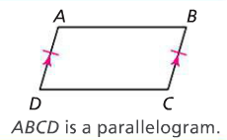
Theorem 2.9
$\overline{AB}∥\overline{CD} and \overline{AB}≅\overline{CD}⇒ABCD is a parallelogram.$

Slide 18
A rectangle
A parallelogram with four right angles

Slide 19
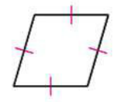
Rhombus
A parallelogram with four congruent sides

Slide 20
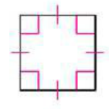
Square
A rectangle with four congruent sides.

Slide 21
Discussion Question
List some special properties of each quadrilateral below
Parallelogram
Kite
Trapezoid

Slide 22
Discussion Question
Are all squares also parallelogram?
Are all parallelograms also squares?

Slide 23
Discussion Question
If a statement is true, must its converse also be true?

Slide 24
Problem 1
Is a quadrilateral with perpendicular diagonals always a kite?

Slide 25
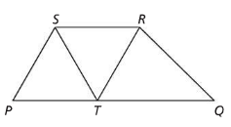
Problem 2
In the figure below, $\overline{ST}≅\overline{RT}$, but the segments are not congruent to $\overline{TQ}$. All angles of $PTS$and $∠RTQ$ measure $60.$ Prove that $PQRS$ is a trapezoid.

Slide 26
Problem 3
Describe the difference between a parallelogram and a rectangle.

Slide 27
Problem 4
Can a kite ever be a parallelogram? Explain.

Slide 28
Problem 5
Prove that a kite can be divided into two isosceles triangles by a single segment.
Can this be done in more than one way? Explain.

Slide 29
Are you ready for 3A?
In 3A, you will learn how to
Devise and follow algorithms to dissect and rearrange one figure into an equal-area figure.
Justify each cut in a dissection.
Write general algorithms for dissections.
Test algorithms with standard and extreme cases.
Don’t forget HOMEWORK!!

