Slide 1
What were we doing in 2C?
Geometry Mathematical Reflection 2C

Slide 2
Habits and Skills
Identify the hypothesis and conclusion of a statement.
Use different methods to write a proof.
Choose an appropriate way to prent a proof.
Recognize the different between experimentation and deduction.

Slide 3
DHoM
Be concise
Leave out unnecessary information
Different approaches
Reverse List is bottom up strategy
Draw a diagram
Be efficient
If you use geometry software, we can play around by just drag it around.

Slide 4
Vocabulary and Notation
Base angle
Base of an isosceles triangle
Conclusion
Equiangular
Hypothesis
Isosceles Triangle
Leg
Proof
Scalene triangle
Vertex angle

Slide 5
Different Styles of Proofs.
Two-Column Statement-Reason Proof
Paragraph Proof
Outline-Style Proof I (Popular in China)
Outline-Style Proof II (Popular in Russia)

Slide 6
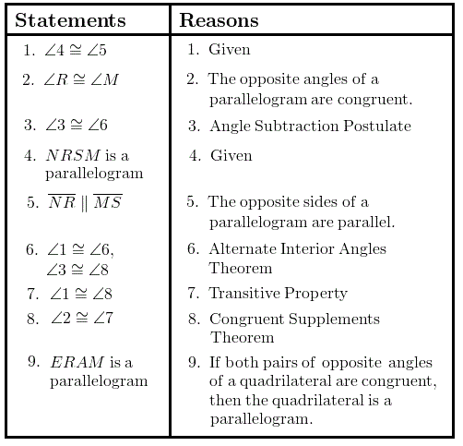
Two-column Statement-Reason Proof
Statement on the left
Reason on the right

Slide 7
Paragraph Proof
A series of sentences fit together logically.
Example:

Slide 8
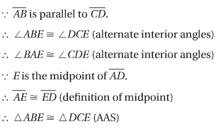
Outline-Style Proof I
Use the symbols
∵ means because to indicate the given information
∴ means therefore.

Slide 9
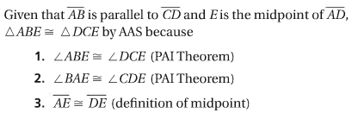
Outline-Style Proof II
Written statement first and then justify each statement.

Slide 10
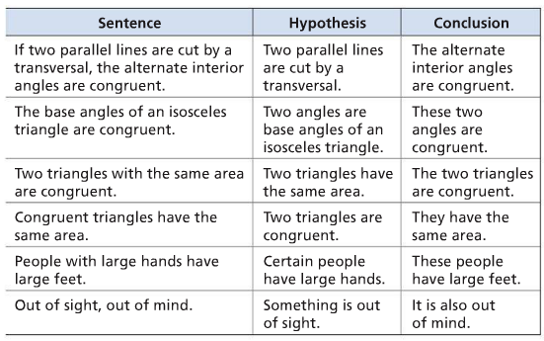
Hypothesis and Conclusion

Slide 11
3 techniques to analyze the proof
Visual Scan
Flow Chart
Reverse List

Slide 12
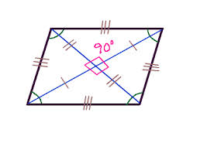
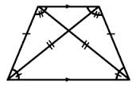
Visual Scan
Draw diagram and tick marks

Slide 13
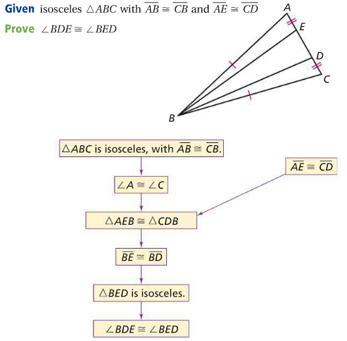
Flow Chart
Top-down analysis technique

Slide 14
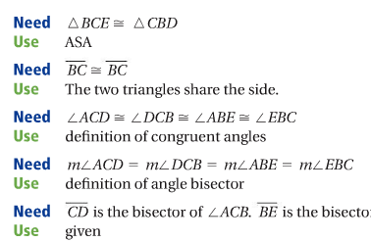
Reverse List
Start from conclusion
And keep asking, “what information do I need?”

Slide 15
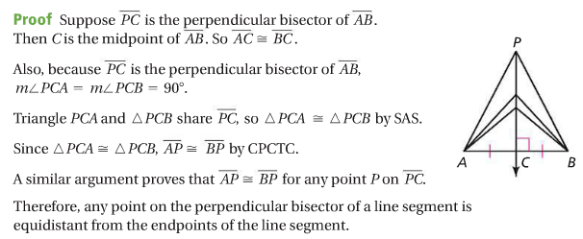
Proof: Perpendicular Bisector Theorem

Slide 16
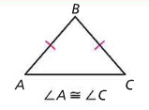

Isosceles Triangle Theorem
$\overline{AB}≅\overline{BC} ⇒ ∠A≅∠C$

Slide 17
Discussion Question
What are the different ways to organize and analyze a proof?
What are the different ways to write a proof?

Slide 18
Discussion Question
What is the Perpendicular Bisector Theorem?

Slide 19
Discussion Question
In the statement “All trees are green,” what is the hypothesis and what is the conclusion.

Slide 20
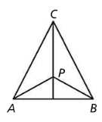
Problem 1
In the figure at the right, $ABC$ is isosceles with $\overline{AC} ≅ \overline{BC}.$ $\overset{⃡}{CP}$ is the bisector of $∠APB$. Point $P$ is on this angle bisector. Prove that $APB$ is isosceles.

Slide 21
Problem 2
The hypotenuse and one of the acute angles of a right triangle are congruent to the hypotenuse and one of the acute angles of another right triangle. Prove that the two triangles are congruent or give a counter example.

Slide 22
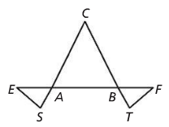
Problem 3
In the figure at the right, $ABC$ is isosceles with $\overline{AC}≅\overline{BC}.$ $\overline{EA}≅\overline{FB}$ and $\overline{AS}≅\overline{BT}.$ Prove that $AES≅BFT$.

Slide 23
Problem 4
The base and the angle opposite the base in one isosceles triangle are congruent to the base and the angle opposite the base in another isosceles triangle. Prove that the two triangles are congruent or provide a counter example.

Slide 24
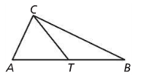
Problem 5
Write a reverse list for this statement about the figure at the right.
If $\overline{TA}≅\overline{TC}≅\overline{TB},$ then $ABC$ is a right triangle.

Slide 25
Are you ready for 2D?
In 2D, you will learn how to
Define and classify quadrilaterals
Write the converse of a conditional statement
Understand the meaning of always, never, and sometimes in mathematics.
Don’t forget HOMEWORK!!

