Slide 1
What were we doing in 2B?
Geometry Mathematical Reflection 2B

Slide 2
Habits and Skills
Develop and present a deductive proof.
Search for invariants.
Visualize key elements of a problem situation.

Slide 3
DHoM
Use a deductive process.
Reason logically.
Generalize.
Read to understand.
Experiment.
Use a different process to get the same result.

Slide 4
Vocabulary and Notation
Alternate exterior angles
Alternate interior angles
Consecutive angles
Converse
Corollary
Corresponding angles
Exterior angles
Parallel lines
Supplementary angles
Transversal
Vertical angles
≇ (is not congruent to)
∥ (is parallel to)

Slide 5
Exterior Angle Theorem

Slide 6
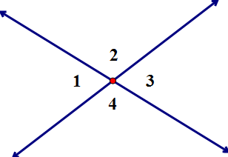

Vertical Angles Theorem
$m∠1=m∠3$
$m∠2=m∠4$

Slide 7
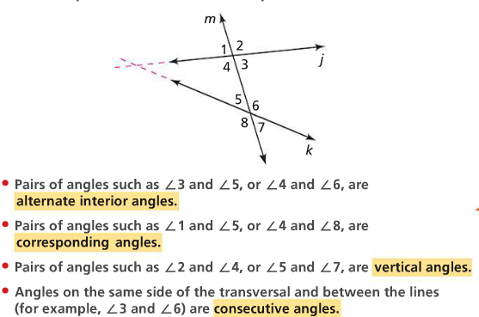
Facts and Notation

Slide 8
The AIP Theorem

Slide 9
The Parallel Postulate

Slide 10
The PAI Theorem

Slide 11
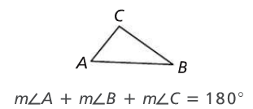
The Triangle Angle-Sum Theorem

Slide 12
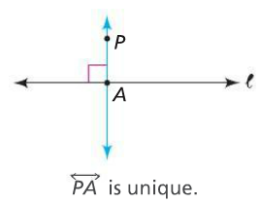
The Unique Perpendicular Theorem

Slide 13
What we know about angles
Vertical angles are congruent.
AI angles are congruent (ONLY if $l∥m$)
Two angles on a straight line add up to 180°.
Three angles in any triangle add up to 180°

Slide 14
Historical Perspective

Slide 15
Discussion Question
Why is proof so important in mathematics.

Slide 16
Discussion Question
Why is it important to keep track of corresponding parts in congruent figures.

Slide 17
Discussion Question
What are some invariant angle relationships when parallel lines are cut by a transversal?

Slide 18
Discussion Question
What is the sum of the measures of the interior angles of any triangle?

Slide 19
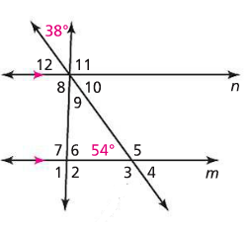
Problem 1
Use the figure below. Find the measure of each numbered angle. Lines $m$ and $n$ are parallel.

Slide 20
Problem 2
Two lines are intersected by a transversal. The measures of the consecutive angles that are formed are $103$ and $75$. Are the two lines parallel? Explain.

Slide 21
Problem 3
Draw two segments $\overline{AB}$ and $\overline{CD}$ that intersect at point $O$ so that $\overline{AO}≅$ $\overline{OB}$ and $\overline{CO}≅$ $\overline{OD}$. Prove that $\overline{AC}≅$ $\overline{BD}$.

Slide 22
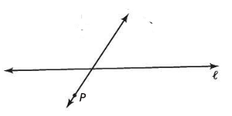
Problem 4
Use the figure below. Explain how to construct a line through P that is parallel to $l.$

Slide 23
Are you ready for 2C?
In 2C, you will learn how to
Use a variety of ways to write and present proofs.
Identify the hypothesis and conclusion of a given statement
Write simple triangle congruence proofs.
Use the Perpendicular Bisector Theorem and the Isosceles Triangle Theorem to prove that two parts of a figure are congruent.

