Slide 1
What were we doing in 2A?
Geometry Mathematical Reflection 2A

Slide 2
Habits and Skills
Name corresponding parts of congruent figures.
Use triangle congruence postulates to show that two triangles are congruent.
Make logical inferences to draw conclusions about congruence.

Slide 3
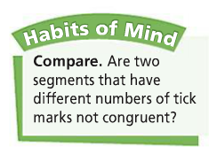
DHoM

Slide 4
Vocabulary and Notation
Postulate
≅ (is congruent to)
$JK$ (length of $\overline{JK}$)
⊥ (Is perpendicular to)

Slide 5
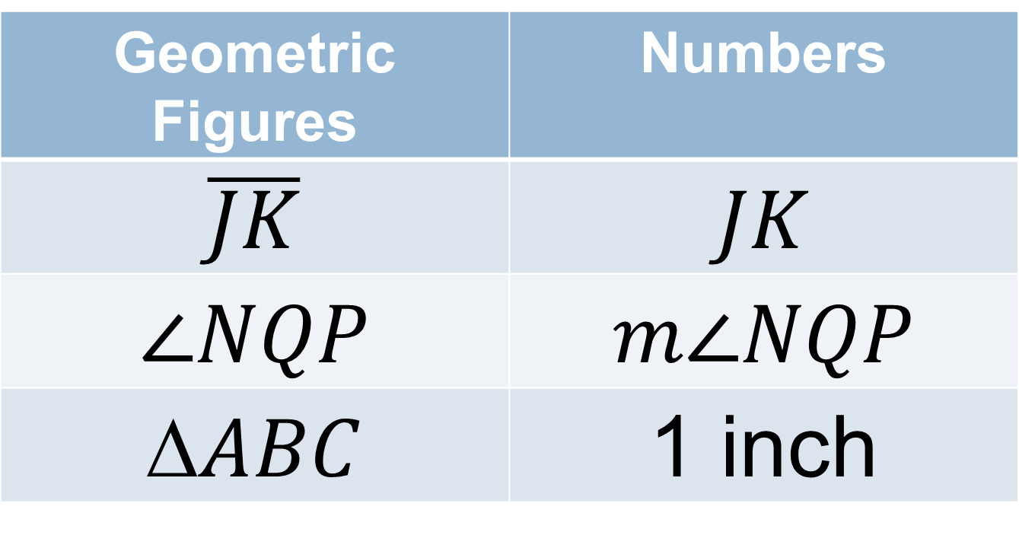
Geometric figures v. numbers
Geometric Figures | Numbers
$$\overline{JK}$$ | $$JK$$
$$∠NQP$$ | $$m∠NQP$$
$$\text{∆}ABC$$ | 1 inch

Slide 6
Numbers are EQUAL
Numbers are lengths (inches, cm, etc.), angle measures (degrees), areas ($ft^{2}$, etc.), volumes (cubic meters, etc.), perimeters ($in.$, etc.)…
$JE=LM$
$m∠NPQ=m ∠RST$
$m∠P=m ∠S$
$Area of ∆ABC=Area of ∆DEF$
$Perimeter of □ABCD=perimeter of □EFG$

Slide 7
Geometric figures are CONGRUENT
A geometric figure means points, segments, angles, triangles, quadrilaterals, pentagons, etc.
$\overline{JK} ≅ \overline{LM}$
$∠NPQ∠RST$
$∠P  ∠S$
$∆ABC  ∆DEF$
$□ABCD  □EFGH$

Slide 8
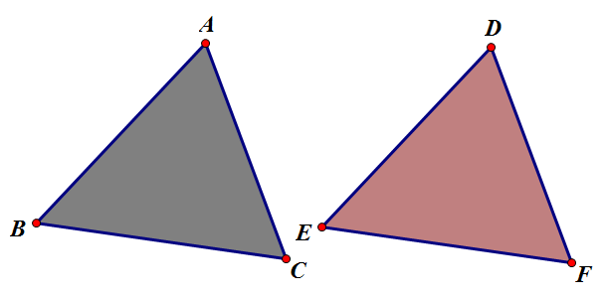
$∆ABC∆DEF$ means…
$∠ABC  ∠DEF,∠BCA  ∠EFD,$& $∠CAB  ∠FDE$
$\overline{AB} ≅ \overline{DE},\text{ }\overline{BC} ≅ \overline{EF},$& $\overline{CA} ≅ \overline{FD}$
$m∠ABC=m∠DEF,m∠BCA=m∠EFD,$& $m∠CAB=m∠FDE$
$AB=DE,\text{ }BC=EF,$& $CA=FD$
But we won’t write everything down

Slide 9
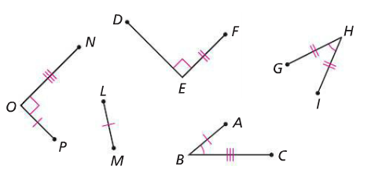
Tick marks
Tick marks are very useful because you can say, “These two segments are congruent,” without actually measuring the lengths.

Slide 10
The Triangle Congruence Postulates
Two triangles are congruent if two triangles share the following triplets of congruent corresponding parts.
Angle-Side-Angle (ASA)
Side-Angle-Side (SAS)
Side-Side-Side (SSS)

Slide 11
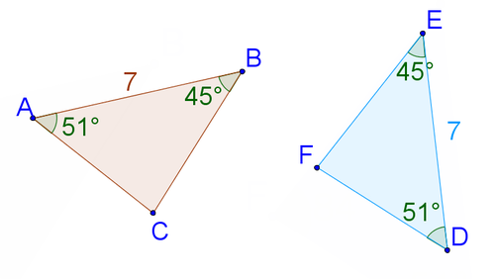
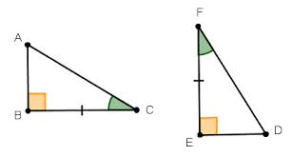
ASA

Slide 12
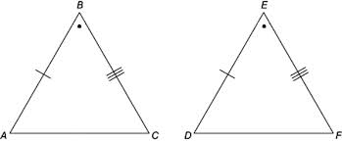
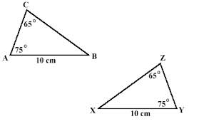
SAS

Slide 13
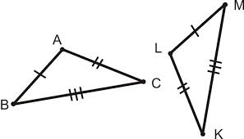
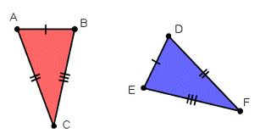
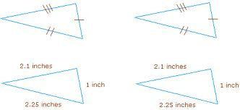
SSS

Slide 14
Discussion Question
What does it mean to say that two figures are congruent?

Slide 15
Discussion Question
Why is it important to keep track of corresponding parts in congruent figures.

Slide 16
Discussion Question
What are some ways to prove that two triangles are congruent?

Slide 17
Problem 1
Name the triangle congruence postulates.
Explain what each one means.
Draw a picture to illustrate each postulate.

Slide 18
Problem 2
Tell whether each statement below makes sense. If a statement does not make sense, explain why. Then rewrite the statement so that it does make sense.
$MA  FL$
$m∠A=m∠L$
$MT=FO$
$\overline{TA} ≅ \overline{LO}$
$∠AMT=∠LFO$

Slide 19
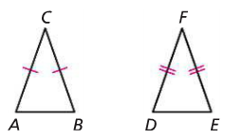
Problem 3
Triangle ABC and $∆DEF$ are isosceles. $\overline{AC}≅ \overline{BC}$ and $\overline{DF}≅ \overline{EF}$. If $∠ACB∠DFE$ and $\overline{CB} ≅ \overline{FD}$, can you determine whether the two triangles are congruent? Explain.

Slide 20
Problem 4
Draw $∆ABC.$ Find the midpoint of $\overline{BC}.$ Call it point $O$. Draw $\vec{AO}$. Mark point $D$ on $\vec{AO}$ so that $\overline{OD} ≅ \overline{OA}.$ Draw $\overline{BD}$ and $\overline{CD}$. Look for congruent triangles in your figure. (Hint: $∠DOB∠AOC$ and $∠AOB∠DOC$). Explain why $\overline{BD }≅ \overline{AC}.$ Explain why $\overline{CD} \text{≅} \overline{AB}.$

Slide 21
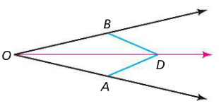
Problem 5
In the figure at the right, $\vec{OD}$ is the angle bisector of $∠AOB$. $\overline{OA} ≅ \overline{OB}.$ Explain why $\overline{AD} ≅ \overline{BD}.$

Slide 22
Are you ready for 2B?
In 2B, you will learn how to
Identify pairs of congruent triangles when parallel lines are cut by a transversal.
Make assumptions and write proofs in order to understand the need for proof in mathematics.
Prove that the sum of the angle measures in any triangle is $180$.

