Slide 1
What were we doing in 1D?
Geometry Mathematical Reflection 1D

Slide 2
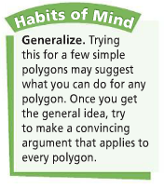
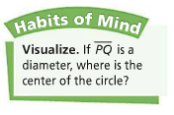
DHoM

Slide 3
Vocabulary
Collinear points
Concurrent lines
Constant
Disc
Invariant

Slide 4
Invariant
Something that is true for each member of a collection.
Numerical invariant is also called a constant.
For example, the sum of interior angles of a triangle is invariant (180 degrees).

Slide 5
$$180(n−2)$$
The sum of interior angles of a
Quadrilateral is $360$
Pentagon is $540$
Hexagon is $720$
7-gon is $900$
8-gon is $1080$…
n-gon is $180(n−2)$

Slide 6
Because…
You can make $(n−2)$ triangles in $n$-gon.
The angle sum of each triangle is $180$.

Slide 7
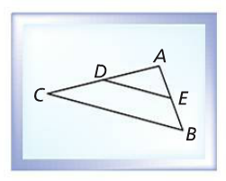
Midline Conjecture
$m\overline{DE}$ is half of $m\overline{BC}$
$\overline{DE}$ is parallel to $\overline{BC}$.

Slide 8
Concurrent lines

Slide 9
Concurrence of Perpendicular Bisectors

Slide 10
Concurrence of Angle Bisectors

Slide 11
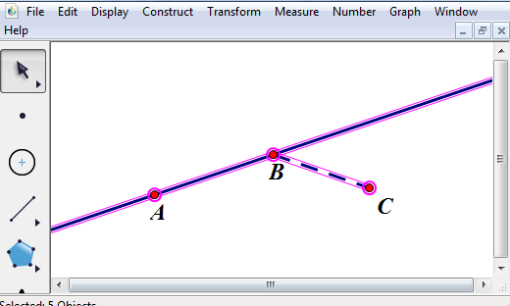
Collinear Points
These points are not collinear.

Slide 12
Discussion Question
What is an invariant?
What kinds of invariants should you look for in geometry?

Slide 13
Discussion Question
What invariant relationship exists when a line parallel to the base of a triangle intersects thee other sides of that triangle?

Slide 14
Discussion Question
What shape do you form when you connect the consecutive midpoints of a quadrilateral?

Slide 15
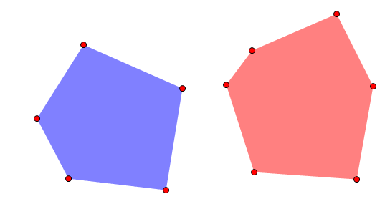
Problem 1
What is the sum of the measures of the angles of a pentagon? Of a hexagon?

Slide 16
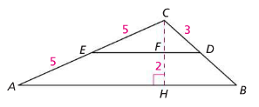
Problem 2
In $∆ABC, D$ and $E$ are the midpoint of $\overline{BC}$ and $\overline{AC}$, respectively. The lengths of some segments are marked. Find $\frac{CD}{CB}$ and $\frac{CF}{CH}$. Explain your reasoning.

Slide 17
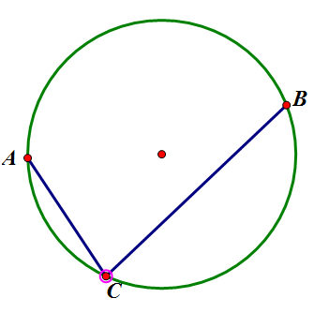
Problem 3
Draw a circle. Place and label two fixed points on the circle. Then place and label a third point on the circle that is not fixed. Build segments from it to each of the two fixed points.
What invariant(s) do you notice in your construction?

Slide 18
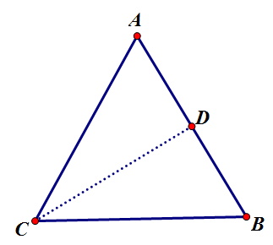
Problem 4
Are the medians of an equilateral triangle concurrent? Explain.

Slide 19
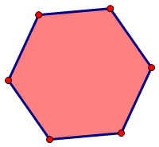
Problem 5
What invariants can you think of for a regular hexagon? List as many as you can.

