Slide 1
What were we doing in 1C?
Geometry Mathematical Reflection 1C

Slide 2
DHoM

Slide 3

Vocabulary
Congruent
$∠ACB$

Slide 4
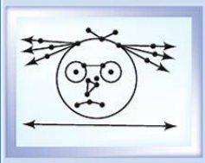
Geometry Software
Do you remember how to draw:
Segment, Ray, Line;
Perpendicular line; and
Parallel line?

Slide 5
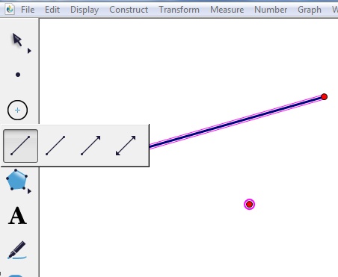
Segment, Ray, Line
What are the difference??

Slide 6
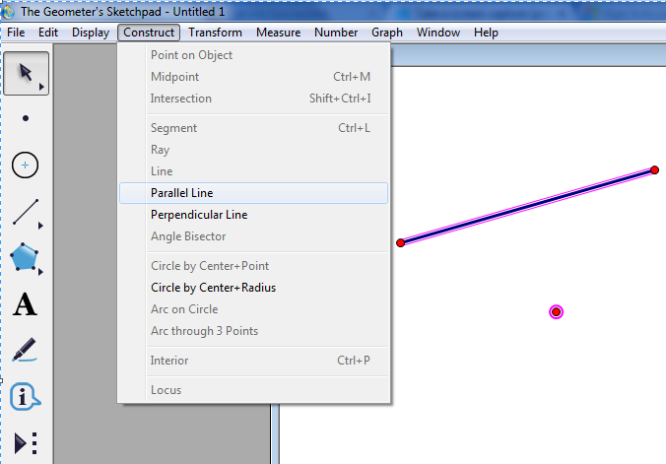
Parallel/ Perpendicular Lines
Draw a segment and a point
Highlight them
Go to “Construct”
Choose
“Parallel Line” or “Perpendicular Line”

Slide 7
“UnMessUpable” Figures
If you draw a square, it might look like it, but you can change it by dragging a vertex or side.
If you construct it, the figure must be “UnMessUpable.”

Slide 8
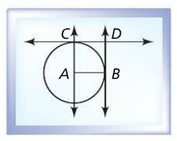
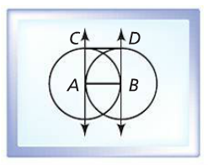
“UnMessUpable” Squares

Slide 9
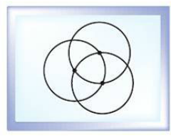
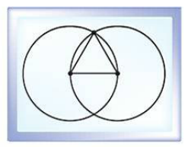
“UnMessUpable” Equilateral Triangles

Slide 10
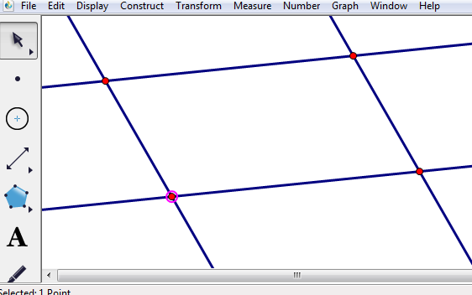
“UnMessUpable” Parallelograms
Two sets of parallel lines

Slide 11
Discussion Question
How can you use geometry software to construct figures with specific features?

Slide 12
Discussion Question
How can you use gemetory software to test for invariants?

Slide 13
Discussion Question
How can you use geometry software to illustrate the difference between drawing a figure and constructing a figure?

Slide 14
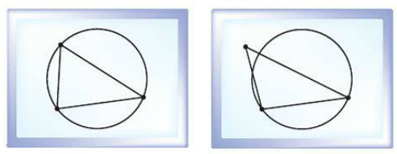
Problem 1
Tony had to construct a triangle inscribed in a circle. He drew the picture on the left. Sasha selected a vertex. She moved it and made the picture on the right. Explain Tony’s mistake.

Slide 15
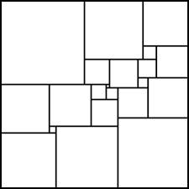
Problem 2
Construct an “UnMessUpable” square with a side length of 5 cm.

Slide 16
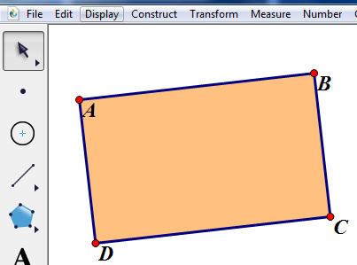
Problem 3
List steps that tell how to construct a rectangle with geometry software. The figure must remain a rectangle for any movement of its vertices.

Slide 17
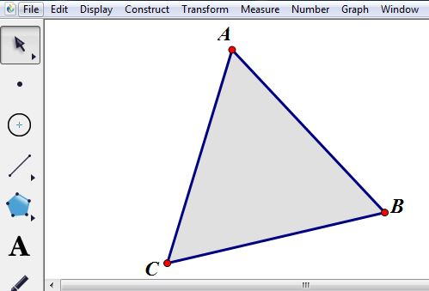
Problem 4
Use geometry software to construct an equilateral triangle with side lengths that vary when you drag a point of the construction.

Slide 18
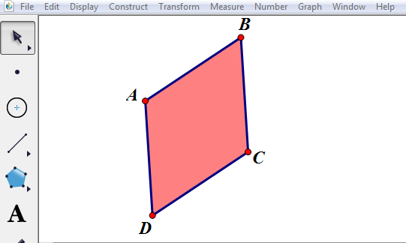
Problem 5
What feature do you have to make invariant in a parallelogram so that it is always a rhombus, no matter how you drag its vertices?

