Slide 1
What were we doing in 1B?
Geometry Mathematical Reflection 1

Slide 2
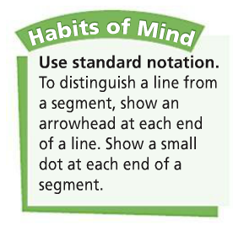
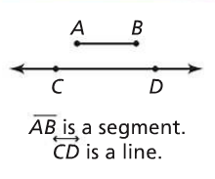
DHoM

Slide 3
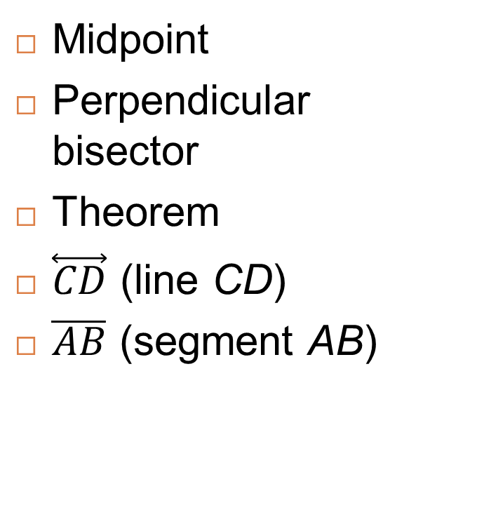
Vocabulary
Altitude
Angle bisector
Construction
Equidistant
Median
midline
Midpoint
Perpendicular bisector
Theorem
$\overset{⃡}{CD}$ (line CD)
$\overline{AB}$ (segment AB)

Slide 4
Construction
Is a guaranteed recipe.
Shows how to accurately draw a figure with a specified set of tools.

Slide 5
Hand Construction Tools
Compass
Straightedge
Measuring devices
A ruler
Protractor
Paper
String

Slide 6
Midpoint
Is the point on a segment that is halfway between the two end points.

Slide 7
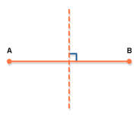
Perpendicular Bisector
Is a line that:
Cross perpendicularly to a segment; and
Splits the segment in half.

Slide 8
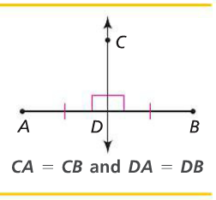
Perpendicular Bisector Theorem
Any point you take on the perpendicular bisector, the distance from the point to each endpoint of the segment is equal.

Slide 9
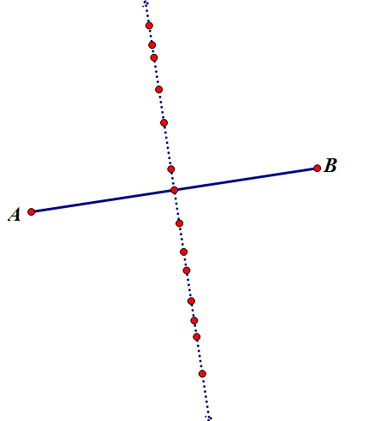
The converse
Of the Perpendicular Bisector Theorem says,
If each point is equidistant from the two endpoints of a segment, then the points are on the perpendicular bisector.

Slide 10
Altitude

Slide 11
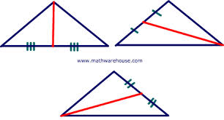
Median
A Triangle has three medians.
Is a segment that connects a vertex of a triangle to the midpoint of the opposite side.

Slide 12
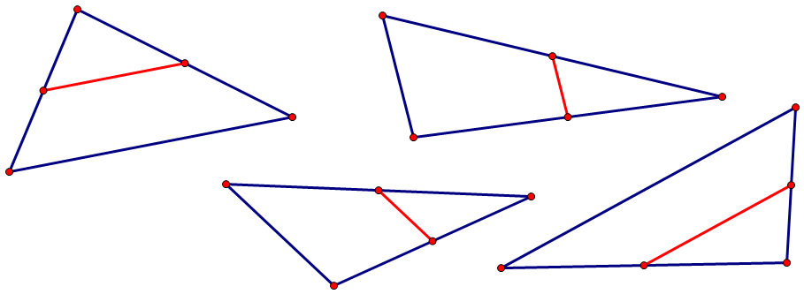
Midline
A triangle has three mid lines.
Is a segment that connects the mid points of two sides of a triangle.

Slide 13
Discussion Question
What is the difference between drawing and constructing a figure?

Slide 14
Discussion Question
What is invariant about the measures of the angles in a triangle?

Slide 15
Discussion Question
How can you construct the perpendicular bisector of a segment?

Slide 16
Problem 1
Describe each shape below using its features. Each description should be specific enough that no other shape can be confused with the given shape.
Isosceles trapezoid
Isosceles triangle
Rhombus
Regular octagon

Slide 17
Problem 2
Draw an angle and construct its bisector.
Describe each step.

Slide 18
Problem 3
Draw $\overline{AC}$.
Construct square such that $\overline{AC}$ is one of its diagonal.

Slide 19
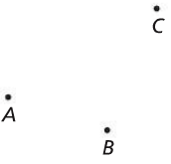
Problem 4
Write the steps that describe how to construct the circle that passes through points A, B, and C below.

Slide 20

Problem 5
Is it possible to construct a triangle with angles that measure $30,60,$ and $90.$
If you think it is possible, construct such a triangle.

