Slide 1
What were we doing in 1A?
Geometry Mathematical Reflection 1A

Slide 2
Vocabulary
Equilateral
Line of symmetry
Line segment
Parallel lines
Parallel planes
Prism
Symmetric

Slide 3
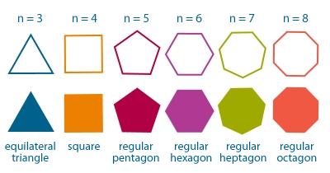
Regular Polygon
Same length, same angles.

Slide 4
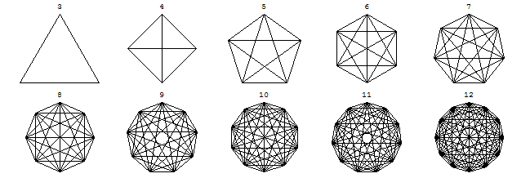
Diagonal
Is a segment that joins two nonconsecutive vertices.

Slide 5
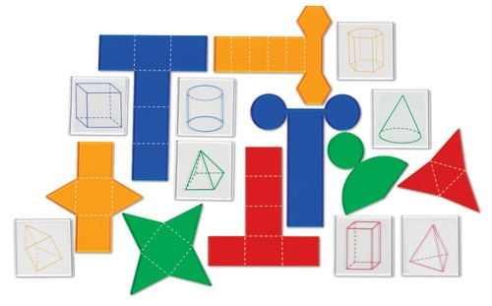
Net
The figure that results from unfolding a 3-D solid.

Slide 6
Cross Section
Is the face you get when you slice an 3-D object.

Slide 7
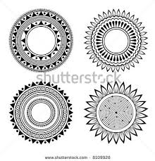
Symmetric
When you can fold a figure in half so that the two halves fit exactly on top of each other, the shape is symmetric.

Slide 8
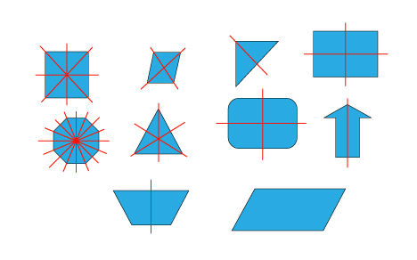
Line of Symmetry
The folding line is called line of symmetry.

Slide 9
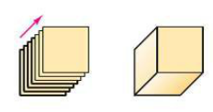
Prism
Is a sold formed by translating a given base shape into the third dimension along a line.

Slide 10
A line segment

Slide 11
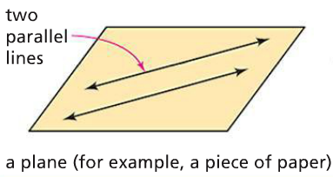
Parallel lines
Are lines in the same plane
that do not intersect.

Slide 12
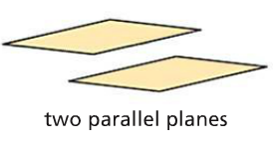
Parallel Planes
Are planes in space that do not intersect.

Slide 13
Discussion Question
What is a line of symmetry?

Slide 14
Discussion Question
What is a prism?

Slide 15
Discussion Question
What should you keep in mind when you give traveling directions to someone or tell someone how to draw a figure or complete a task?

Slide 16
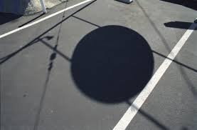
Problem 1
Name three kinds of shapes that can cast a circular shadow. Explain your reasoning.
Name a shape that cannot cast a circular shadow. Explain your reasoning.

Slide 17
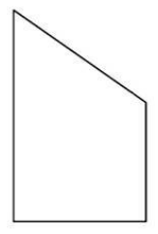
Problem 2
Draw a three-dimensional block version of the figure at right.
Label the base.
Shape any visible parallel faces.

Slide 18
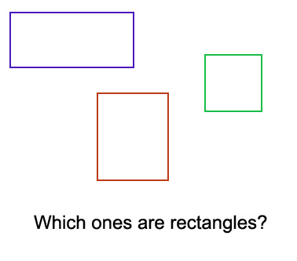
Problem 3
How many lines of symmetry does a square have?
How many lines of symmetry does a rectangle have?
Can a rectangle every have the same number of lines symmetry as a square?

Slide 19
Problem 4
Read the following recipe.
Draw two horizontal parallel segments that are the same length.
Connect the two left endpoints.
Connect the two right end point.
Draw a shape described by this recipe.
Does this recipe describe only one shape? Explain.

Slide 20
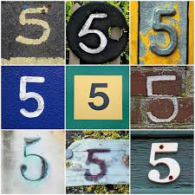
Problem 5
Write careful directions that describe how to draw the number 5. Use any geometry terms that might make your directions more clear.

